Slide 1
Correcting for Sample Overlap in Association Meta-analysis Using Summary Statistics
Sebanti Sengupta
11/15/2017

Slide 2
Background
Meta-analysis an important strategy for genetic association studies
Increases sample size and power
Can lead to discovery of novel loci
Can use previously published study results
What happens if different studies in the meta-analysis have samples in common?
We wish to estimate the ‘bottom-line’ p-value that corrects for sample overlap
Use summary statistics (Z-score, allele frequency, sample size)

Slide 3
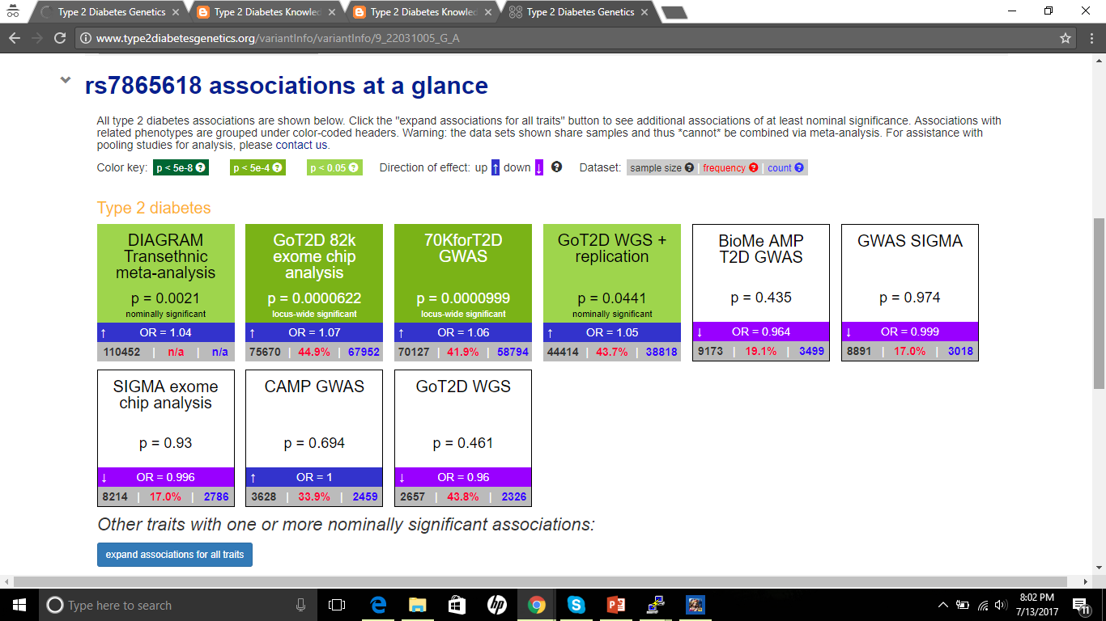

Slide 5
Standard Meta-analysis Method
Usual way to combine estimates from different studies:
$$\hat{η}= \sum_{k=1}^{K}{w_{k} {\hat{η}}_{k}}$$
$$\text{Var}\left(\hat{η}\right)= \sum_{k=1}^{K}{w_{k}^{2}V_{k}}$$
where
${\hat{η}}_{k}$ is the estimator of interest from the $k^{th}$ study (eg. Z-score or log odds ratio),
$V_{k}$ the corresponding estimated variance
$w_{k}$ the weight used for the $k^{th}$ study in the meta-analysis

Slide 6
Standard Meta-analysis Method
Usual way to combine estimates from different studies:
$$\hat{η}= \sum_{k=1}^{K}{w_{k} {\hat{η}}_{k}}$$
$$\text{Var}\left(\hat{η}\right)= \sum_{k=1}^{K}{w_{k}^{2}V_{k}}$$
Not true if samples overlap

Slide 7
Standard Meta-analysis Method
Usual way to combine estimates from different studies:
$$\hat{η}= \sum_{k=1}^{K}{w_{k} {\hat{η}}_{k}}$$
$$\text{Var}\left(\hat{η}\right)= \sum_{k=1}^{K}{w_{k}^{2}V_{k}}$$
$$\text{Var}\left(\hat{η}\right)= \sum_{k=1}^{K}{w_{k}^{2}V_{k}}+2 \sum_{k=1}^{K−1}{\sum_{l=k+1}^{K}{w_{k}w_{l} \text{Cov}}\text{(}{\hat{η}}_{k}\text{, }{\hat{η}}_{l}\text{) }}$$
Not true if samples overlap

Slide 8
Standard Meta-analysis Method
Usual way to combine estimates from different studies:
$$\hat{η}= \sum_{k=1}^{K}{w_{k} {\hat{η}}_{k}}$$
$$\text{Var}\left(\hat{η}\right)= \sum_{k=1}^{K}{w_{k}^{2}V_{k}}$$
$$\text{Var}\left(\hat{η}\right)= \sum_{k=1}^{K}{w_{k}^{2}V_{k}}+2 \sum_{k=1}^{K−1}{\sum_{l=k+1}^{K}{w_{k}w_{l} \text{Cov}}\text{(}{\hat{η}}_{k}\text{, }{\hat{η}}_{l}\text{) }}$$
Idea: estimate the covariance term using summary statistics
Not true if samples overlap
Notes:
Ensures that var=1, uses weights $\left[w_{1},…w_{K}\right]={e^{T}Ω^{−1}}/{e^{T}Ω^{−1}e}$ where e is vector of 1s, and $Ω$ is estimated covariance matrix of $η$

Slide 9
Method
Stratify Markers by N
Estimate Covariance using Truncated Z-scores
Meta-analyze Correcting for Overlap
Assume that samples are homogeneous, that is, belong to the same ancestry
Allele frequencies and effect sizes same in all samples
Do not vary with overlap

Slide 10
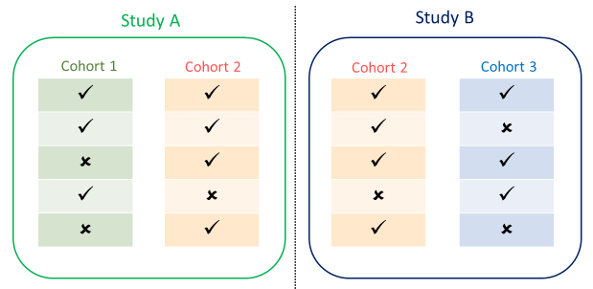
Stratifying Markers by Sample Size
The overlap number for a marker M may differ depending on whether it is present in the overlapping samples or not
Overlap Number
$$n_{2}$$
$$n_{2}$$
$$n_{2}$$
0
$$n_{2}$$
Possible combinations for a marker M
where sample size of Cohort 2 is $n_{2}$

Slide 11
Estimating Covariance
Suppose the trait is independent of all markers, then sample correlation of the Z-scores can be used to estimate the covariance
$$\hat{\text{Cov}}\left(Z_{i}, Z_{j}\right)=r_{ij}$$
Trait associated loci are expected to show correlation even when samples are independent
Use Z-scores truncated at some cut-off value $c (\text{abs}\left(Z\right)<c)$, to estimate the correlation
Most results shown use $c=1$

Slide 12
Correcting for Overlap
Meta-analysis done by adjusting the covariance term in the weights
The updated weights to correct for overlap are as follows:
$$\hat{Z}= \frac{1}{\sqrt{\sum_{k}{w_{k}^{2}}+{\sum_{i}{\sum_{j≠i}{w_{i}w_{j}}}r}_{ij}}} \sum_{k=1}^{K}{{w_{k}Z}_{k}}$$

Slide 13
Effective Sample Size of Overlap
We estimate effective sample size of overlap as:
$$n_{overlap}=\sqrt{n_{1}n_{2}}r_{12}$$
Note that this need not be the actual number of samples overlapping
Eg: For case-control studies, the overlap estimated may correspond to a range of overlap numbers depending on what proportion of cases and controls overlap respectively

Slide 14
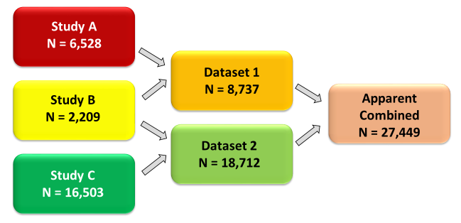
Creating Overlapping Datasets: Case-Control Study (T2D)
3 European Studies from DIAMANTE: FUSION, METSIM and MGI
True combined sample size 25,240

Slide 15
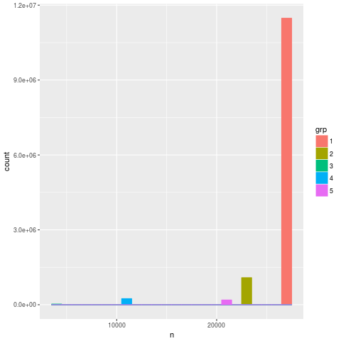
Estimated Overlap Stratified by Sample Size
N | Category | Estimated Overlap | CI
4,418 | B+B | 2,209 | (2,187, 2,209)
10,946 | A+B+B | 2,225 | (2,175, 2,262)
20,921 | B+B+C | 2,656 | (2,540, 2,765)
23,031 | A+C | 176 | (52, 311)
27,449 | A+B+B+C | 2,326 | (2,238, 2,365)
Count of Markers
Observed Sample Size
Z-scores truncated at cutoff = 1

Slide 16
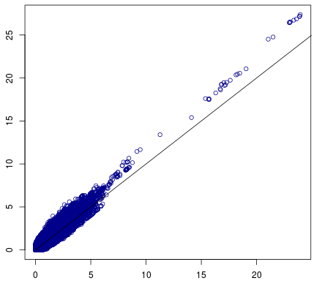
Meta-Analysis Results
Meta-analysis without Correcting for Overlap
-log10 Naive Meta-analysis P-value
-log10 Target P-value

Slide 17
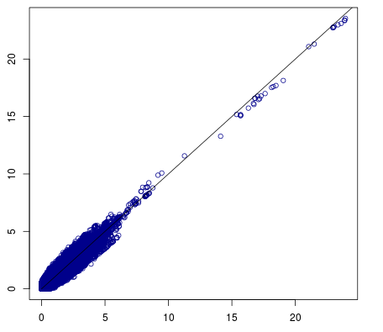
Meta-Analysis Results
Meta-analysis without Correcting for Overlap
Meta-analysis Correcting for Overlap
-log10 Naive Meta-analysis P-value
-log10 New Method P-value
-log10 Target P-value
-log10 Target P-value

Slide 18
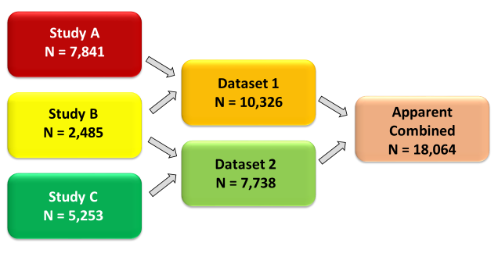
Creating Overlapped Datasets: Quantitative Trait
GLGC European Cohorts, Trait HDL-cholesterol
True combined sample size 15,579

Slide 19
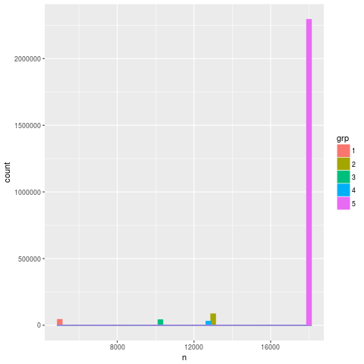
Estimated Overlap Stratified by Sample Size
Sample Size | Category | Estimated Overlap | CI
4,970 | B+B | 2,485 | (2,478, 2,485)
10,223 | B+B+C | 2,409 | (2,324, 2500)
12,811 | A+B+B | 2,448 | (2,305, 2583)
13,094 | A+C | 0 | -
18,064 | A+B+B+C | 2,546 | (2,458, 2,592)
Count of Markers
Observed Sample Size
Z-scores truncated at cutoff = 1

Slide 20
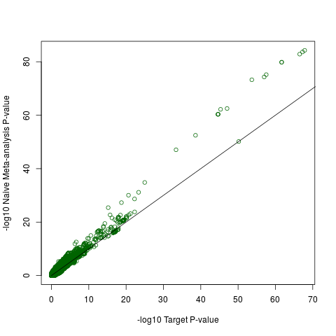
Meta-analysis Results
Meta-analysis without Correcting for Overlap
-log10 Naive Meta-analysis P-value
-log10 Target P-value

Slide 21
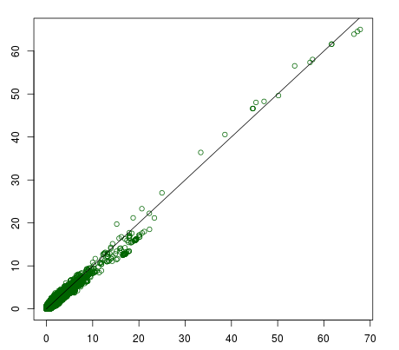
Meta-analysis Results
Meta-analysis without Correcting for Overlap
Meta-analysis Correcting for Overlap
-log10 Naive Meta-analysis P-value
-log10 Weight-stratified Adjusted P-value
-log10 Target P-value
-log10 Target P-value

Slide 22
Meta-Analysis with Multiple Studies
For multiple studies, meta-analysis is conducted sequentially
When meta-analyzing a pair of studies $i$ and $j$, for each marker we calculate
$$\text{Total} \text{Weight} W\text{ = }\sqrt{w_{i}^{2}+w_{j}^{2}+{2∗w}_{i}w_{j}r_{ij}}$$
$$\text{Effective} \text{Sample} \text{Size} N=N_{i}+N_{j}−n_{overlap}$$
$$Z=\frac{1}{W}(w_{i}Z_{i}+w_{j}Z_{j})$$
and this total weight is used when meta-analyzing the combined Z with a new study

Slide 23
In Summary
When different studies in a meta-analysis have overlapping samples, the standard methods lead to an inflation in type I error
If overlapping sample sizes are unknown, effective overlap sample size can be estimated
Assuming samples belong to the same ancestry
Actual overlap numbers may differ depending on overlap pattern
Covariance estimated using truncated Z-scores used to correct for overlap in meta-analysis

Slide 24
Acknowledgements
Goncalo Abecasis
Michael Boehnke
Daniel Taliun

Slide 25
Thanks!

Slide 26
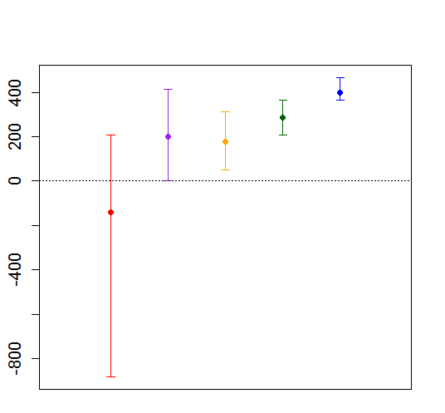
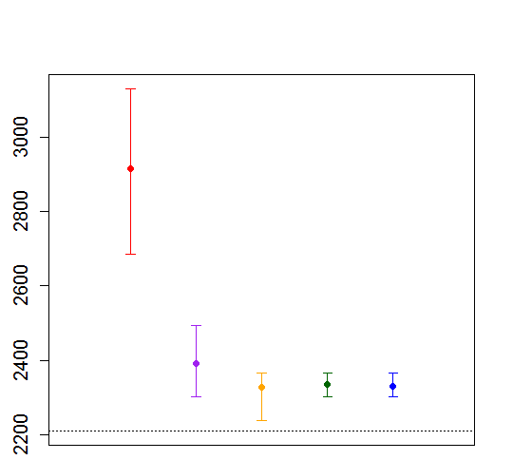
Estimated Overlap by Varying Cutoff Values: T2D
Estimated Effective Sample Size of Overlap
Estimated Effective Sample Size of Overlap
N = 23,031
N = 27,449

Slide 27
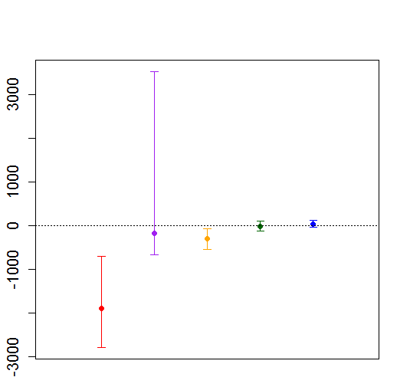
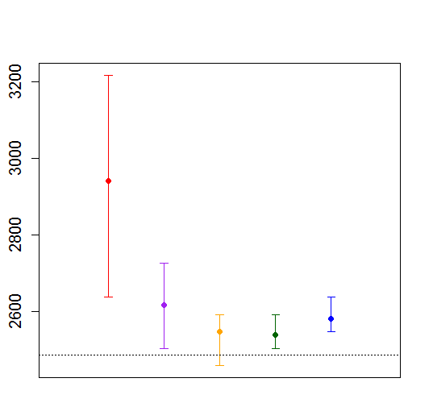
Estimated Overlap for Varying Cut-off Values: GLGC
Estimated Effective Sample Size of Overlap
Estimated Effective Sample Size of Overlap
N = 13,094
N = 18,064

