Slide 1
Identifying Genes for Type 2 Diabetes by GWAS and Sequencing Studies
Michael Boehnke
Department of Biostatistics
Center for Statistical Genetics
University of Michigan
Sequencing Symposium
December 8, 2014

Slide 2
Introduction
Discovery genetics seeks to identify the genetic basis for human diseases (and traits)
Why?
  better understand human biology, disease etiology
  suggest targets for therapy
  allow better targeting of therapies
  improve risk prediction
Common variant association studies have identified >90 loci for type 2 diabetes (T2D)
Now using sequencing to explore the full frequency spectrum of genetic variation

Slide 3
Progress in identifying gene
variants for common traits
MEIS1
LBXCOR1
BTBD9
C3
8q24
ORMDL3
4q25
TCF2
GCKR
FTO
C12orf30
ERBB3
KIAA0350
CD226
16p13
PTPN2
SH2B3
FGFR2
TNRC9
MAP3K1
LSP1
8q24
HMGA2
GDF5-UQCC
HMPG
JAZF1
CDC123
ADAMTS9
THADA
WSF1
LOXL1
IL7R
TRAF1/C5
STAT4
ABCG8
GALNT2
PSRC1
NCAN
TBL2
TRIB1
KCTD10
ANGLPT3
GRIN3A
8q24 #2
8q24 #3
8q24 #4
8q24 #5
8q24 #6
ATG16L1
5p13
10q21
IRGM
NKX2-3
IL12B
3p21
1q24
PTPN2
CDKN2B/A
TCF2
IGF2BP2
CDKAL1
HHEX
SLC30A8
Cholesterol
Obesity
Myocardial infarction
QT interval
Atrial fibrillation
Type 2 diabetes
Prostate cancer
Breast cancer
Colon cancer
Height
Age related macular degeneration
Crohn’s disease
Type 1 diabetes
Systemic lupus erythematosus
Asthma
Restless leg syndrome
Gallstone disease
Multiple sclerosis
Rheumatoid arthritis
Glaucoma
NOS1AP
IFIH1
PCSK9
CFB/C2
LOC387715
8q24
IL23R
TCF7L2
CD25
IRF5
PCSK9
CFH
IBD5
NOD2
PPARγ
CTLA4
KCNJ11
PTPN22
2000
2001
2002
2003
2004
2005
2006
2007
Slide courtesy of David Altshuler
Notes:
It is easy to forget that even 10 years ago, there were precious few successes in identifying genetic variants associated
with common human diseases. This figure now seems a little bit quaint.

Slide 4
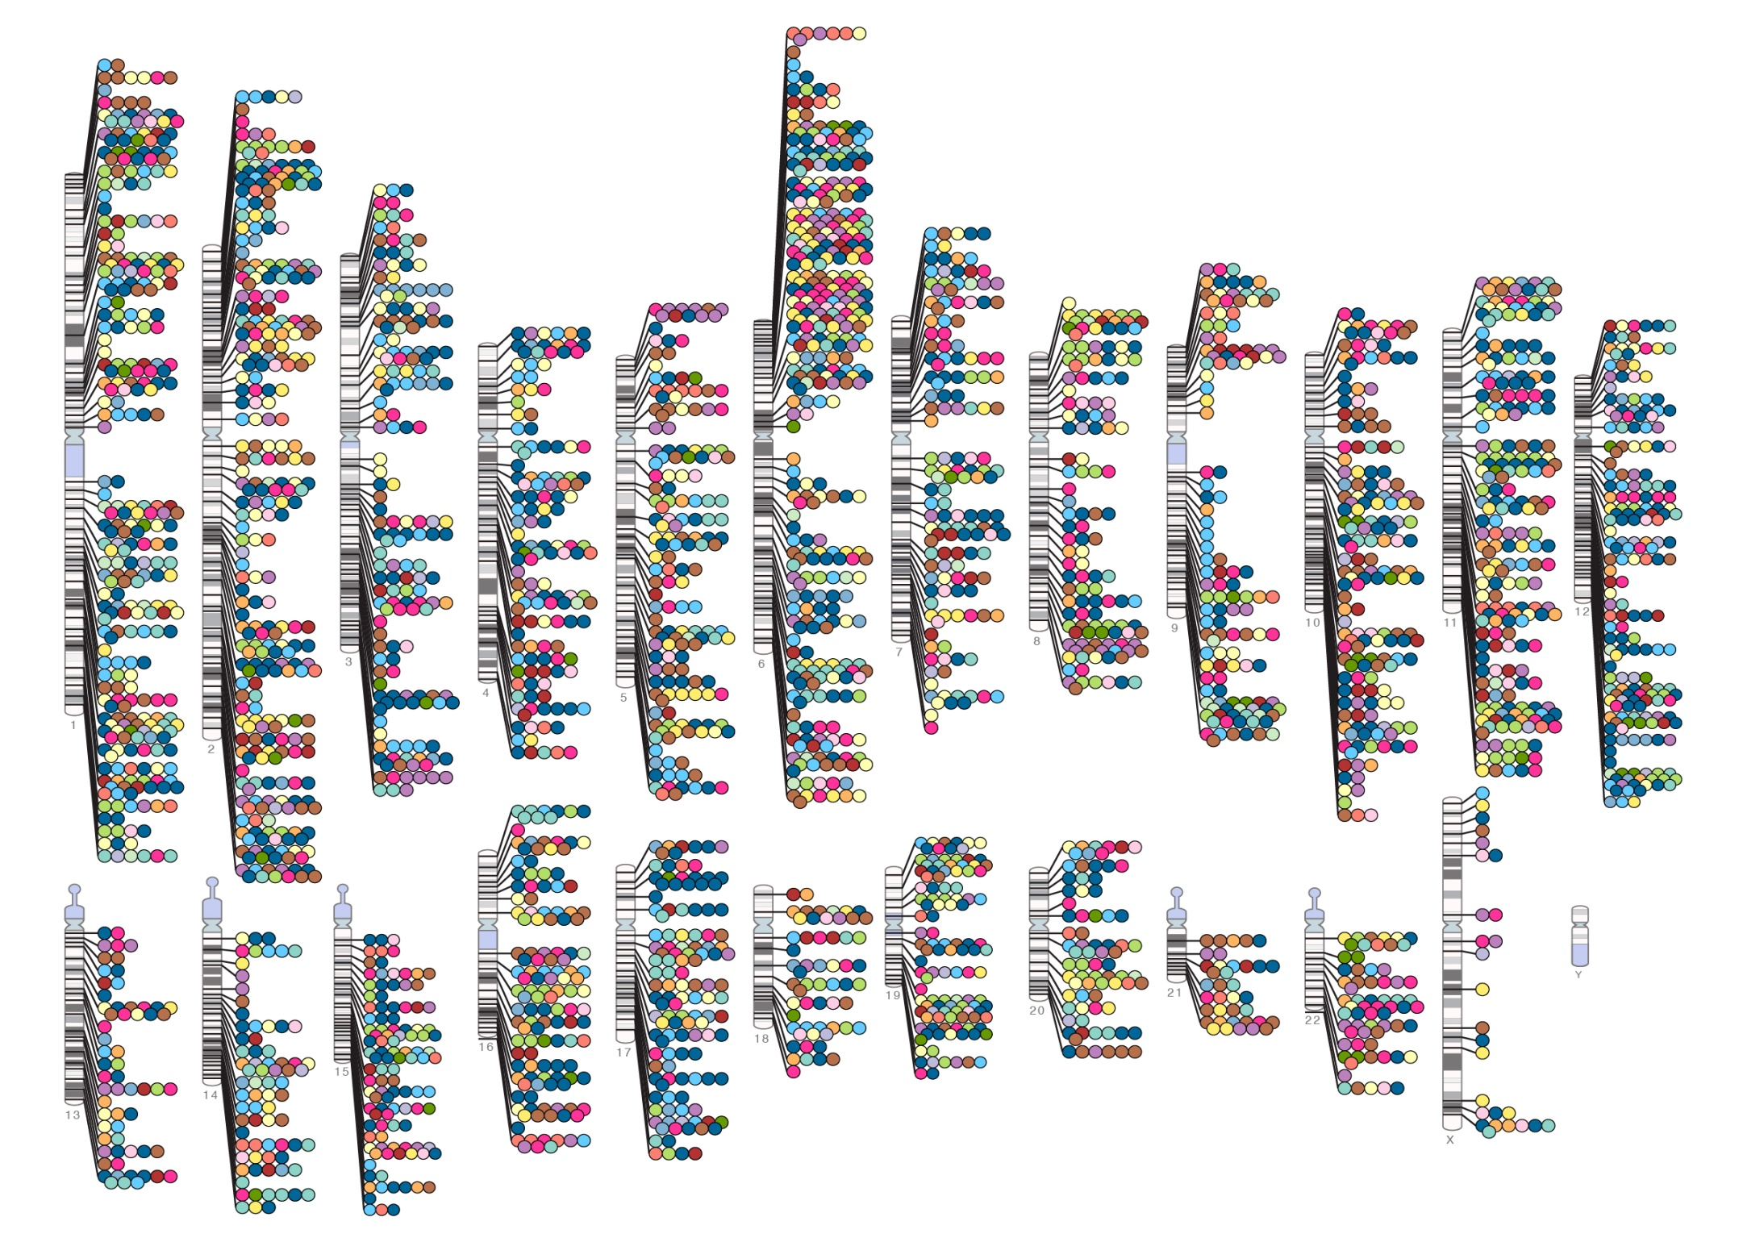
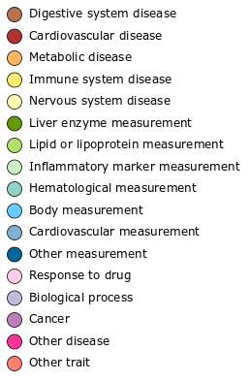

Published Genome-Wide Associations through 12/2012
Published GWA at p≤5X10⁻⁸ for 17 trait categories
NHGRI GWA Catalog
www.genome.gov/GWAStudies
www.ebi.ac.uk/fgpt/gwas/
Notes:
We now have made a good start on identifying the role of common variants on human disease risk
GWAS have identified 1000s of loci at which common variants are associated with common diseases and traits

Slide 5
Outline of presentation
FUSION study of T2D
GWAS and GWAS meta-analyses of T2D
T2D association studies with custom genotyping chips: metabochip, exome chip
T2D exome- and genome-wide sequencing studies

Slide 6
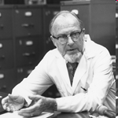
Why (or not) a genetic study of T2D?
T2D huge, growing public health problem
  300 million worldwide; ↑ rapidly
  substantial morbidity, mortality
  10% of US health care costs
T2D strongly familial
Despite much effort, even as recently as 2006, consensus on only three T2D genes: PPARG, KCNJ11, TCF7L2
Jim Neel: diabetes is “the geneticist’s nightmare”

Slide 7
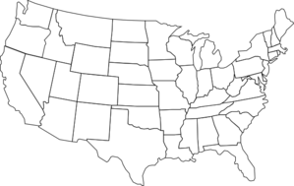
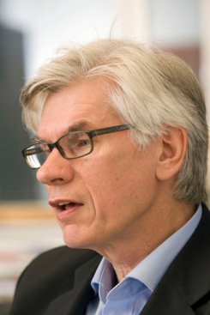
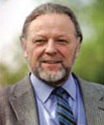
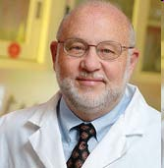

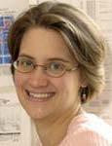
FUSION: Finland-United States Investigation of NIDDM Genetics
NHGRI, Bethesda, Francis Collins
Cedars Sinai, Los Angeles, Richard Bergman
National Public Health Institute, Helsinki, Jaakko Tuomilehto
U North Carolina, Karen Mohlke
U Eastern Finland, Markku Laakso
U Michigan, Michael Boehnke
7
Notes:
7

Slide 8
FUSION Study Goals
Identify genetic variants that predispose to type 2 diabetes (T2D) or are responsible for variability in T2D-related traits

Slide 9
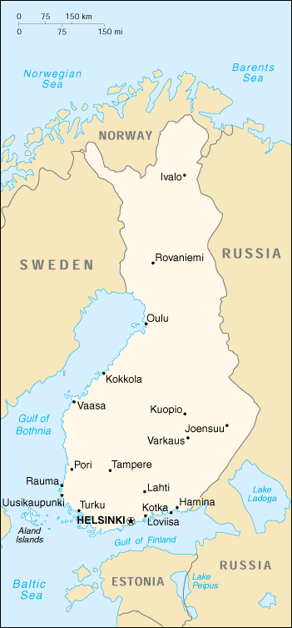
FUSION ASP Families for Linkage Analysis
FUSION started in mid 1990s as a T2D family study
Sampled >5000 individuals from >800 families with ≥2 affected siblings
Obtained extensive phenotype information
Genotyped participants at ~400 genetic markers
Notes:
Primary design is linkage study like in families, except use only siblings affected with disease.
Structure of families collected
At least 2 affected sibs. Also collected parents, if still alive and in many cases, extended to collect spouses and offspring. Can use their genotypes to determine haplotypes. Also a number of traits better studied in at-risk individuals rather than those with disease.
Also perform association study using one case per family versus two types of controls; unaffected spouses plus independent set of unrelated elderly controls. Based on age, old enough that unlikely to get diabetes.

Slide 10
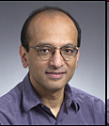
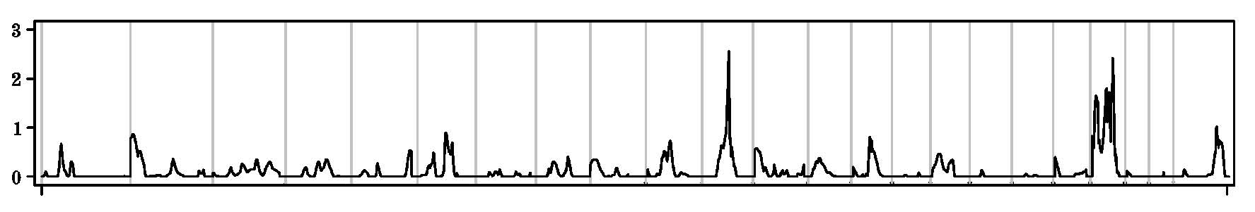
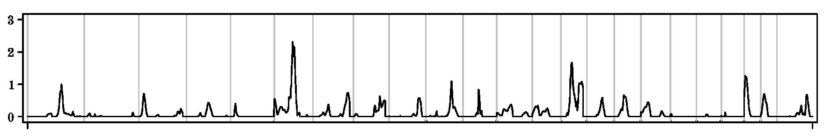

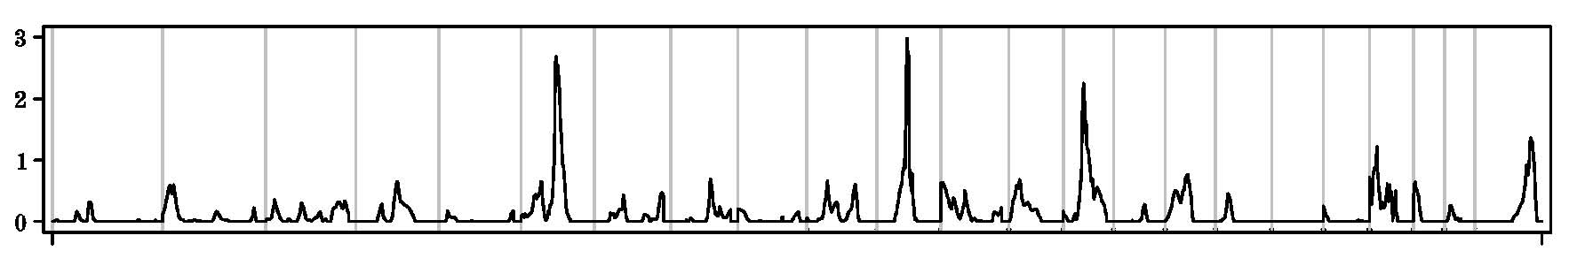
FUSION T2D Sib Pair Linkage Studies
Chromosome
1 2 3 4 5 6 7 8 9 10 11 12 13 14 15 16 17 18 19 20 21 22 X
FUSION 1
LOD
FUSION 2
LOD
FUSION 1+2
LOD
1 2 3 4 5 6 7 8 9 10 11 12 13 14 15 16 17 18 19 20 21 22 X
Ghosh et al. Am J Hum Genet 67:1174, 2000; Silander et al. Diabetes 53:821, 2004

Slide 11
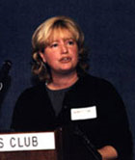



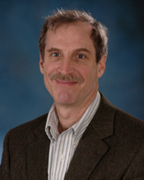
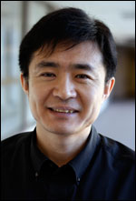
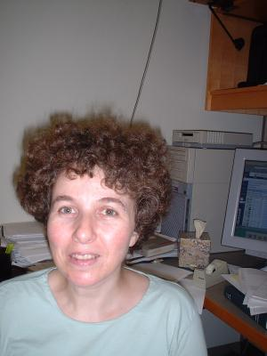
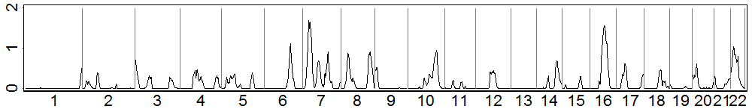
International T2D Linkage Analysis Consortium
Approach: combine linkage data across studies
>6000 families from ~20 studies
Guan et al. Human Heredity 2008
N Cox
D Burns
S Elbein
P Froguel
B Mitchell
W Guan
A Pluzhnikov
LOD
11
11
11
Notes:
11
11
11

Slide 12
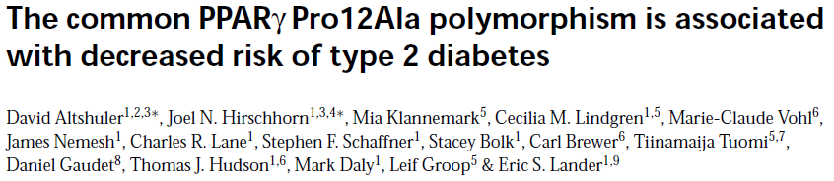

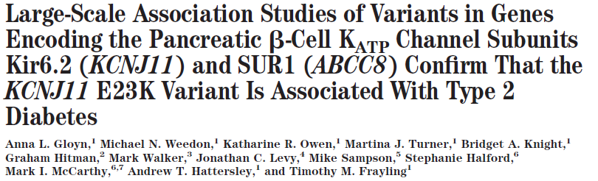
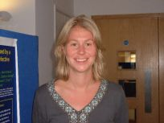
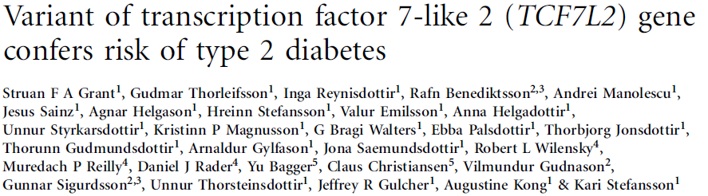

Nature Genetics 2000
Diabetes
2003
Nature Genetics 2006

Slide 13
Genome-Wide Association Study (GWAS)
Risch and Merikangas Science 1996
Sample many individuals with and without disease (e.g. cases with T2D, controls without)
Genotype individuals for 100,000s of genetic markers across the genome
Test for disease-marker association
Identify markers showing statistical association with disease, suggesting disease gene near marker

Slide 14
Drop in Genotype Costs
Cost per
genotype
$1.00
ABI
TaqMan
Sequenom
ABI
SNPlex
$0.10
Illumina
Golden Gate
Affymetrix
MegAllele
Affymetrix
10K
Perlegen
$0.01
Affymetrix
100K/500K-1M
Illumina
Infinium-1-5M
# of
SNPs
1
10
10²
10³
10⁴
10⁵
10⁶
2001
2010
Slide courtesy of Stephen Chanock
Notes:
14

Slide 15
Drop in Genotype Costs
Cost per
genotype
Now: $70 for 1M SNPs, < $10⁻⁴ per genotype
$1.00
ABI
TaqMan
Sequenom
ABI
SNPlex
$0.10
Illumina
Golden Gate
Affymetrix
MegAllele
Affymetrix
10K
Perlegen
$0.01
Affymetrix
100K/500K-1M
Illumina
Infinium-1-5M
# of
SNPs
1
10
10²
10³
10⁴
10⁵
10⁶
2001
2010
Slide courtesy of Stephen Chanock
Notes:
15

Slide 16
FUSION GWAS and Follow-Up
Stage 1 (GWAS) samples:
T2D cases 1161
NGT controls 1174
Stage 2 (follow-up) samples:
T2D cases 1215
NGT controls 1258
Stage 1 genotyped on Illumina
317K; best markers typed in Stage 2
80% power to detect OR of 1.3-1.4
Notes:
Primary design is linkage study like in families, except use only siblings affected with disease.
Structure of families collected
At least 2 affected sibs. Also collected parents, if still alive and in many cases, extended to collect spouses and offspring. Can use their genotypes to determine haplotypes. Also a number of traits better studied in at-risk individuals rather than those with disease.
Also perform association study using one case per family versus two types of controls; unaffected spouses plus independent set of unrelated elderly controls. Based on age, old enough that unlikely to get diabetes.

Slide 17
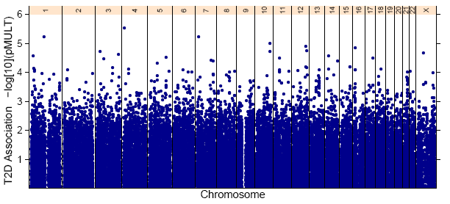
FUSION Stage 1 GWAS
1161 Finnish T2D cases + 1174 Finnish NGT controls
-log₁₀(p-value)
Logistic regression, additive genetic model

Slide 18
FUSION Stage 1 GWAS: Known Positives
1161 Finnish T2D cases + 1174 Finnish NGT controls
TCF7L2
-log₁₀(p-value)
PPARG
KCNJ11
Logistic regression, additive genetic model

Slide 19
FUSION-Alone GWAS and Follow-Up
No compelling findings in FUSION stage 1
After follow-up of 31 most promising SNPs, clear evidence for TCF7L2, nothing else
For “geneticist’s nightmare,” needed more samples
Happily, decided that before
carrying out our study
19
Notes:
19
Used results from both the genotyped and imputed data to select SNPs to gt in Stage 2

Slide 20



Three-Study Collaboration
FUSION: Finnish cases and controls
Diabetes Genetic Initiative (DGI): Finnish, Swedish cases and controls
UKT2D: UK cases, controls
FUSION genotyped Illumina 317K DGI, UK Affymetrix 500K
Notes:
Combined results of stage 1 from all studies.
Each group performed some stage 2 genotyping based on meta-analysis signals.
Will show pvalues for combined stage 1 and 2 from all three studies.

Slide 21
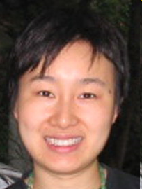

Three-Study Collaboration
FUSION: Finnish cases and controls
Diabetes Genetic Initiative (DGI): Finnish, Swedish cases and controls
UKT2D: UK cases, controls
FUSION genotyped Illumina 317K DGI, UK Affymetrix 500K
Combine results across studies with different marker sets by genotype imputation (Li, Abecasis et al.)
Notes:
Combined results of stage 1 from all studies.
Each group performed some stage 2 genotyping based on meta-analysis signals.
Will show pvalues for combined stage 1 and 2 from all three studies.

Slide 22
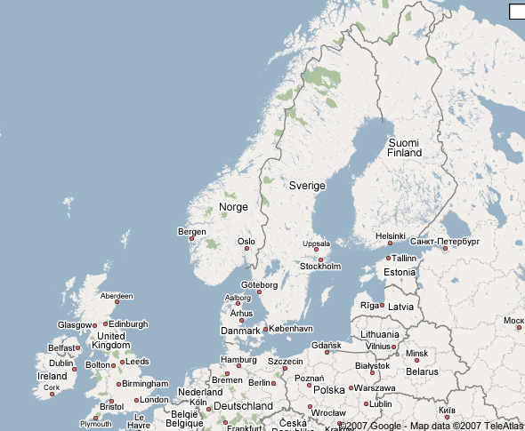
FUSION, DGI, UK Cases + Controls
FUSION
  1: 1161 + 1174
  2: 1215 + 1258
DGI
  1: 1464 + 1467
  2: 5065 + 5785
WTCCC/UKT2DGC
  1: 1924 + 2938
  2: 3757 + 5346
TOTAL
  1: 4549 + 5579
  2: 10037+12389
Sweden
United States
(off map)
Poland
22
Notes:
22
Total > 32,000

Slide 23
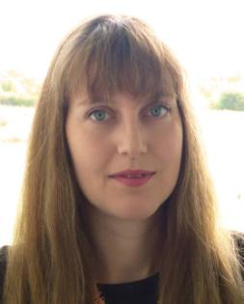
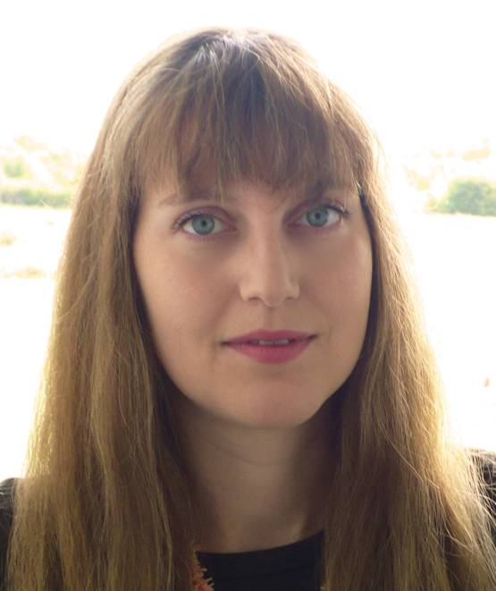


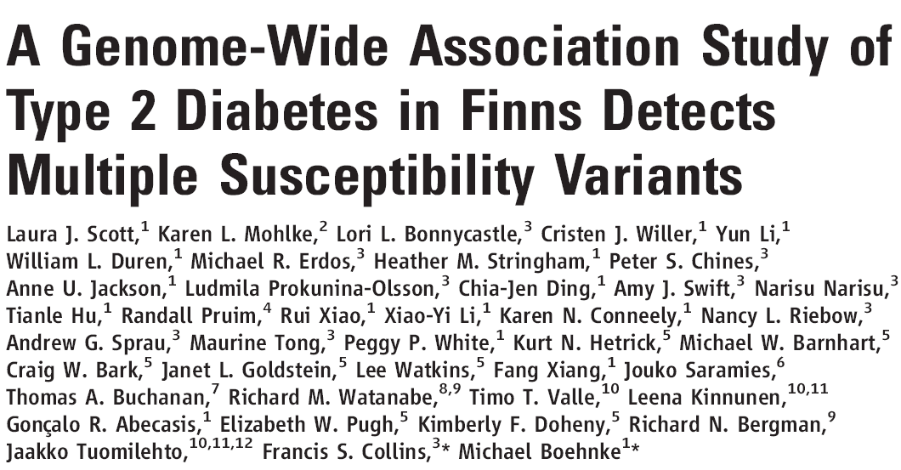
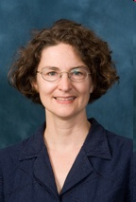
Science
April 2007
23
23

Slide 24
Association Results: FUSION, DGI, UK
Scott, Saxena, Zeggini et al. Science 2007
Nearby Gene | OR | P-value | Nearby Gene | OR | P-value
TCF7L2 | 1.37 | 1 x 10⁻⁴⁸ | IGF2BP2 | 1.14 | 9 x 10⁻¹⁶
KCNJ11 | 1.14 | 7 x 10⁻¹¹ | CDKN2A/B | 1.20 | 8 x 10⁻¹⁵
PPARG | 1.14 | 2 x 10⁻⁶ | FTO | 1.17 | 1 x 10⁻¹²
HHEX | 1.13 | 6 x 10⁻¹⁰ | CDKAL1 | 1.12 | 4 x 10⁻¹¹
SLC30A8 | 1.12 | 5 x 10⁻⁸
24
Notes:
24
Top 10 results our perspective. Sorted by all sample pvalue.
Blue are three frequently replicated loci
Variability in strength of association across studies
Biologists see new loci shown here. Will discuss more.

Slide 25
DIAGRAM Meta-Analysis and Follow-Up
DGI, UK subsequently carried out imputation allowing more complete meta-analysis of three GWAS samples
DIAGRAM = FUSION + DGI + UK meta-analysis
of >2.1 million genotyped and imputed
HapMap SNPs
69 SNPs followed up in stage 2 samples, 11 in stage 3
6 new T2D loci: JAZF1, CDC123/CAMK1D, TSPAN8, THADA, ADAMTS9, NOTCH2
Zeggini, Scott et al. Nature Genetics 2008
Notes:
Combined results of stage 1 from all studies.
Each group performed some stage 2 genotyping based on meta-analysis signals.
Will show pvalues for combined stage 1 and 2 from all three studies.

Slide 26
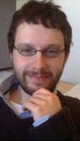

DIAGRAM + T2D GWAS Meta-Analysis
Voight, Scott et al. DIAGRAM (2010)
Added GWAS results from KORA,
DCDG, deCODE, Rotterdam, Eurospan
GWAS: 8,130 T2D; 38,987 controls
Follow-up: 34K T2Ds; 60K controls
12 more T2D loci

Slide 27
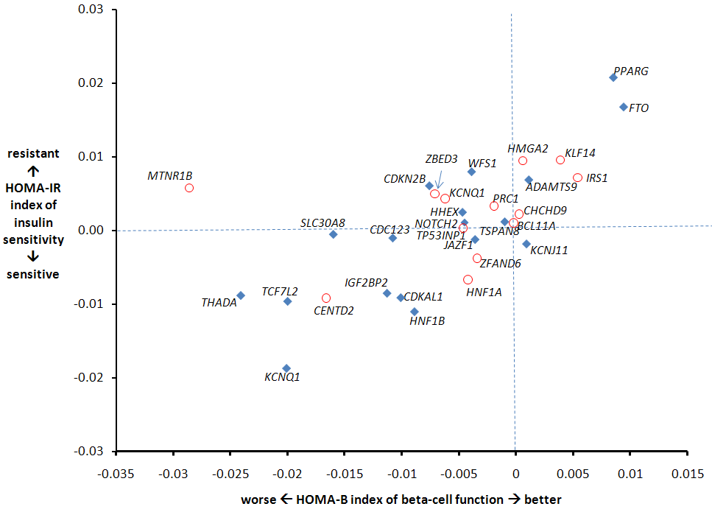
Relative Roles of Insulin Secretion and Action
HOMA-B and HOMA-IR
37,000 GWA individuals
Non-diabetic FG<7
MAGIC consortium
Insulin resistance
Mostly beta-cell genes, but some insulin resistance genes appearing
Beta-cell dysfunction
Slide courtesy of Mark McCarthy

Slide 28
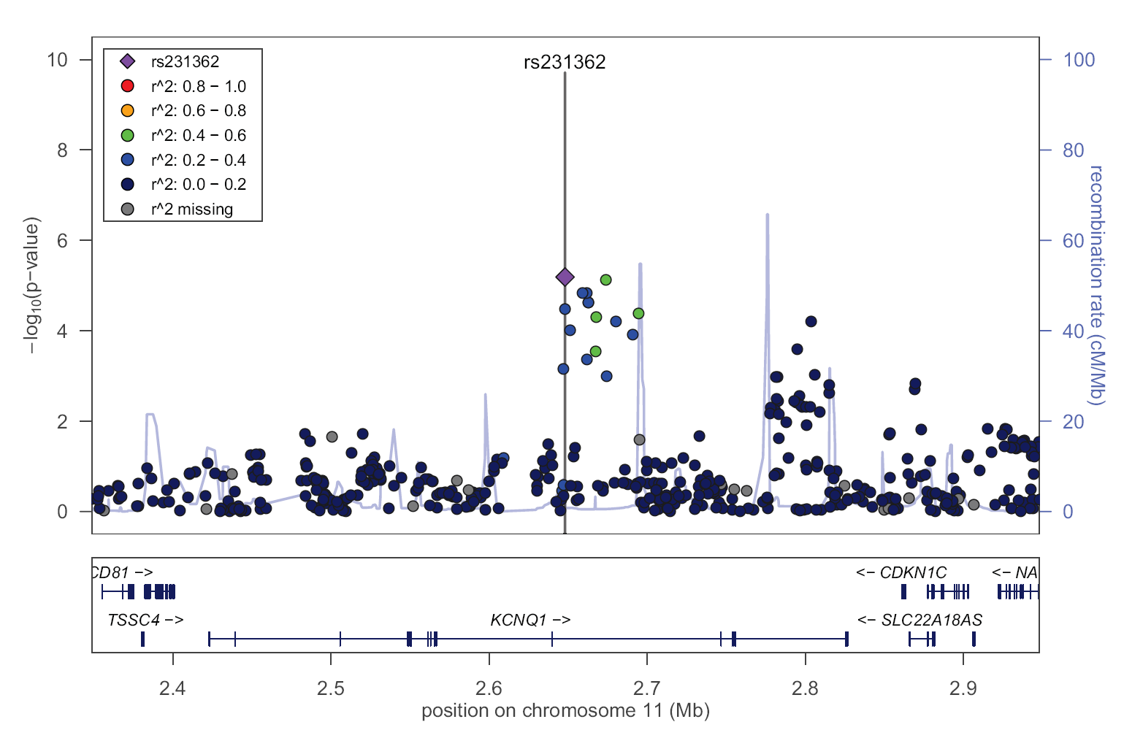
KCNQ1 (chromosome 11)
r²<.02
r²<.05
New T2D signal
Yasuda et al
Unoki et al
QT interval
Multiple independent signals for multiple traits
Slide courtesy of Mark McCarthy

Slide 29
Next steps
GWAS meta-analysis remarkably successful identifying T2D-associated common variants; still much to find
Additional common variants:
  Additional GWAS (in other ancestry groups)
  More detailed imputation: larger sequenced reference sets
  Further follow-up: e.g. Metabochip
Additional (less common) T2D variants: exome chip and large-scale re-sequencing

Slide 30
>90 loci associated with type 2 diabetes
Discovered in:
Europeans
East Asians
South Asians
Multi-Ethnic
Other Groups
ANKRD55
ANK1
TLE1
ZMIZ1
KLHDC5
BCAR1
MC4R
CILP2
GIPR
CCND2
LAMA1
BCL2
GATAD2A
TMEM163
RBM43-RND3
MACF1
COBLL1
DNER
MIR129-LEP
GPSM1
GRK5
SGCG
RASGRP1
SLC16A13
FAM58A
FAF1
LPP
TMEM154
ARL15
SSR1-RREB1
POU5F1-TCF19
MPHOSPH9
PAM
PDX1
MTNR1B
GCK
DGKB
GCKR
ADCY5
PROX1
BCL11A
ZBED3
KLF14
TP53INP1
TLE4
CENTD2
HMGA2
HNF1A
ZFAND6
PRC1
DUSP9
SRR
UBE2E2
RBMS1
PTPRD
SPRY2
C2CD4/B
GRB14
ST6GAL1
VPS26A
HMG20A
AP3S2
HNF4A
MAEA
GLIS3
GCC1-PAX4
PSMD6
ZFAND3
PEPD
KCNK16
JAZF1
CDC123/CAMK1D TSPAN8/LGR5
THADA
ADAMTS9
NOTCH2
KCNQ1
IGF2BP2
CDKAL1
CKDN2A/B
FTO
HNF1B
WFS1
PPARG
SLC30A8
HHEX
TCF7L2
KCNJ11
DUSP8
IRS1
Slide courtesy of Xueling Sim
Notes:
Substantial progress for T2D

Slide 31
Explore the Full Allele Frequency Spectrum
We have made excellent start, but much more to do in discovery genetics of T2D and related traits
Common variants explain only portion of disease heritability; for most diseases and traits, h² < 50%
At only a few risk loci is gene, direction of effect, mechanism, impact on physiology identified
Low-frequency variants will help understand many of these loci and remainder of genome
  extent, effect size distribution now being revealed
  suggest function, druggable targets, clinical action
Notes:
Want to understand new biology
How do we identify drugs
Accelerate progress

Slide 32
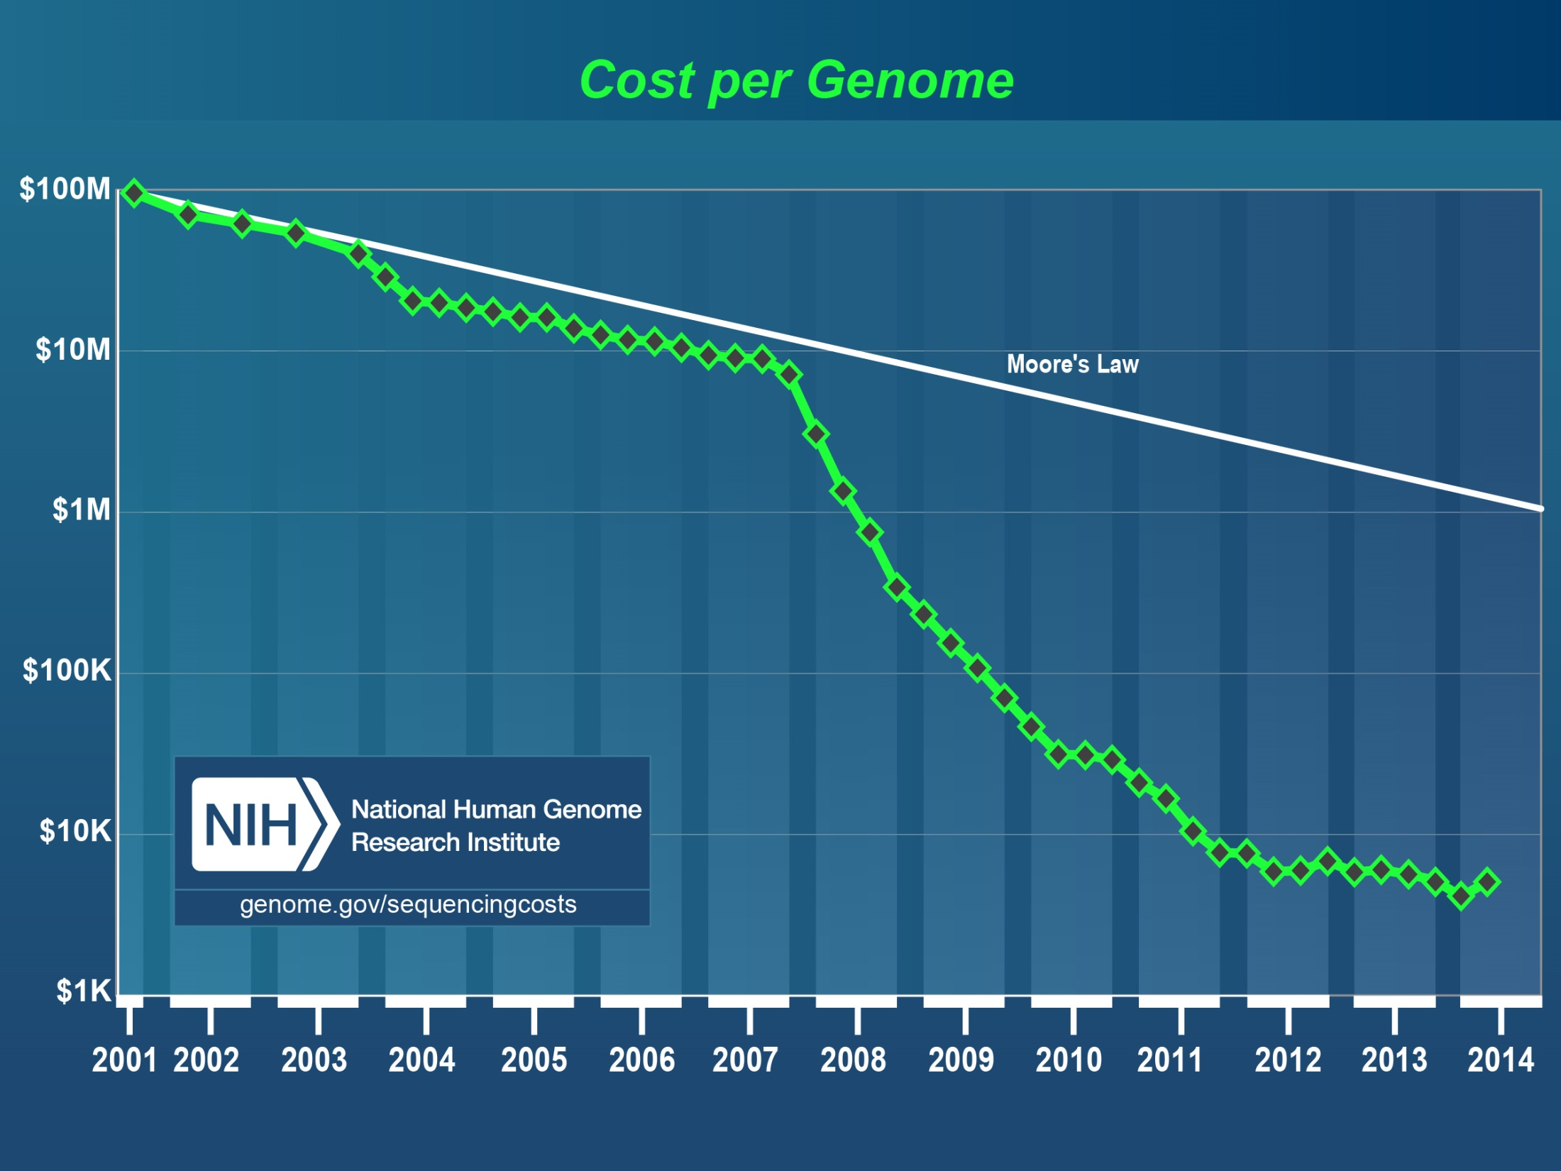
Notes:
Drop in genotyping and sequencing costs has been critical to common disease genetics
Last 3 years have been relatively quiet on that front
We hope and expect sequencing costs to again drop substantially in the next 6-12 months
Can take advantage of this to explore the impact of low-frequency variants on common human diseases

Slide 33

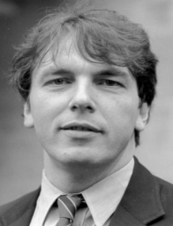
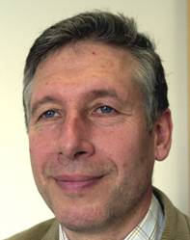
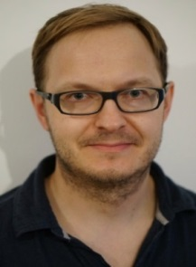


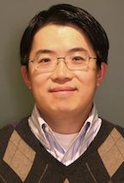
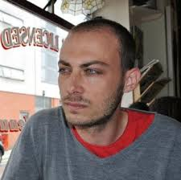
GoT2D
Genetics of Type 2 Diabetes
Identify T2D variants by
  Low-pass (4x) genome sequencing
  Deep exome sequencing
  2.5M SNP chip genotyping
1425 T2Ds, 1425 controls from Finland, Sweden, UK, Germany; “extremes”
Identify T2D variants; develop methods/tools/strategies to identify association with less common variants
Funded by NIH (ARRA), Wellcome Trust

Slide 34








T2D-GENES
Type 2 Diabetes Genetic Exploration by Next-generation sequencing in multi-Ethnic Samples
NIDDK consortium of 5 consortia to identify genetic determinants of T2D across multiple ancestry groups
Responders to RFA-DK-09-004: Multiethnic Study of T2D Genes
Together planned and executed three major projects

Slide 35
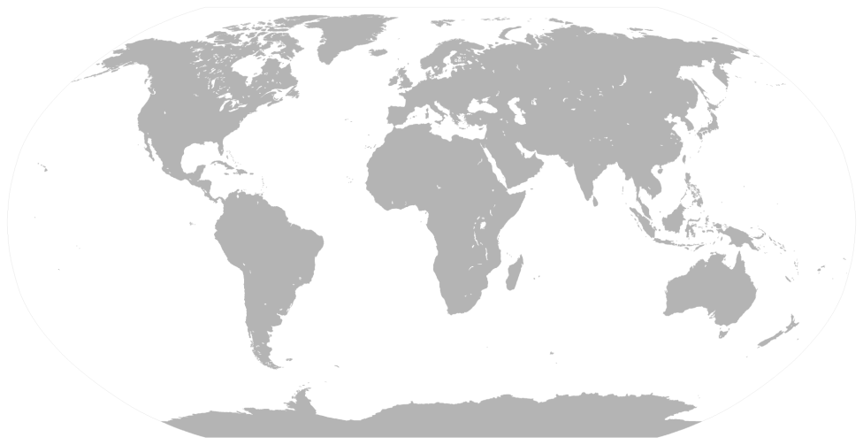
GoT2D + T2D-GENES Project 1
Exome sequence 12,940 individuals from 5 ancestries
6,504 T2D cases / 6,436 controls
Hispanic
European
East Asian
African American
1,021 / 922
San Antonio, TX
Starr County, TX
South Asian
1,018 / 1,056
Jackson Heart Study
Wake Forest Study
1,094 / 1,123
LOLIPOP (Indians in the UK)
Singapore Indians
1,012 / 1,153
KARE (Korea)
Singapore Chinese
2,359 / 2,182
Ashkenazim
METSIM (Finland)
FUSION (Finland)
KORA (Germany
Diabetes Registry (Sweden/Finland)
WTCCC/UK Biobank (United Kingdom)
Notes:
We performed exome sequencing in almost thirteen thousand exomes from 5 different ancestry groups: African-American, East Asian, Hispanic, South Asian, and European, ascertained on T2D case control status. Within each ancestry, we sampled from two or more independent populations, making up approximately 1000 T2D case control pairs. The African-American populations are from Jackson Heart Study and Wake Forest, and the Hispanic populations are both sampled from Texas, San Antonio Study and Starr County. South Asians comprised of Indians living in Singapore and London, and the East Asian populaions are from Singapore and Korea. Finally, we have the Europeans, consisting of Ashkenazi from Isreal and New York, METSIM study from Finland, and about 2,600 exomes from GoT2D project, originating from Finland, Germany, Sweden and UK). Of note, the Singapore Chinese samples are actually from the Singapore Population Health Studies (former known as SCCS). The Singapore Indians samples were contributed from the Singapore Indian Chinese Cohort led by Prof Wong Tien Yin.

Slide 36
Key Questions
Does (exome) sequence analysis identify novel T2D-associated variants or genes?
At known T2D GWAS loci, are low-frequency and rare variants associated with T2D?
Same questions for T2D-related quantitative traits (QTs).

Slide 37

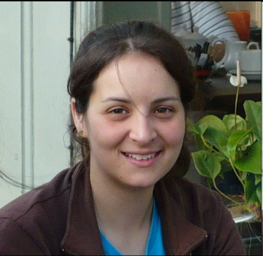
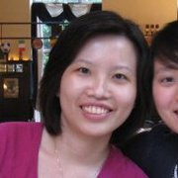
Most Variants Rare and Ancestry-Specific
3.0M | 1.8M | 1.2M | 69.7K | # Variants
0.77 | 0.97 | 0.47 | 0.13 | Mean MAF (%)
All ancestries
2-4 ancestries
Single ancestry
Notes:
We look at the variants discovered through this sequencing. This barchart shows the proportion of all variants discovered, that are present in single (coloured blue), multiple (red) or all ancestries (green). Most variants are ancestry-specific.

Slide 38
Most Variants Rare and Ancestry-Specific
3.0M | 1.8M | 1.2M | 69.7K | # Variants
0.77 | 0.97 | 0.47 | 0.13 | Mean MAF (%)
All ancestries
2-4 ancestries
Single ancestry
Notes:
We further classify all variants into their different functional annotation class, synonymous, non-synonymous to protein-truncating. As variants get increasingly damaging, the mean allele frequency decreases, and a higher proportion of these are specific to one ancestry.

Slide 39
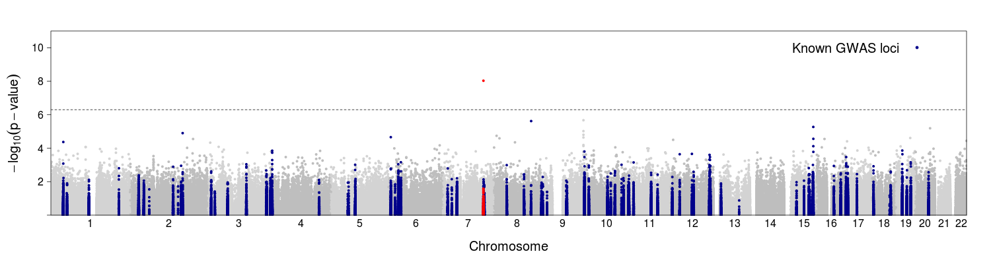
PAX4 R192H is Associated with T2D in East Asians
Driven exclusively by East Asians
Only 3 copies of the allele seen in non East Asians (3 / 21,550)
PAX4 (Paired box gene 4) R192H
Study | Minor allele frequency MAF (%) | OR [95% CI] | P-value
KARE (Koreans) | 7.7 | 1.86 [1.34 – 2.58] | 1.4x10⁻⁴
Singapore Chinese | 12.8 | 1.76 [1.37 – 2.25] | 7.4x10⁻⁶
Combined | 10.2 | 1.75 [1.43 – 2.13] | 9.2x10⁻⁹
Notes:
Moving into the association results, this is a manhattan plot, very commonly used in genetic studies, where we plot the –log10 pvalues against chromosome position. The dotted line indicates the significance level at 5e-7. We see a single point that exceeds the exome-wide threshold, at the PAX4 gene. Interestingly it is driven exclusively by East-Asians. We only see 3 copies of the alleles in the non East-Asians samples. It is a common variant, with frequency close to 10% when combined across the two East-Asian studies. Individuals carrying the allele are at 75% higher odds of developing t2d compared to the non-carriers.

Slide 40
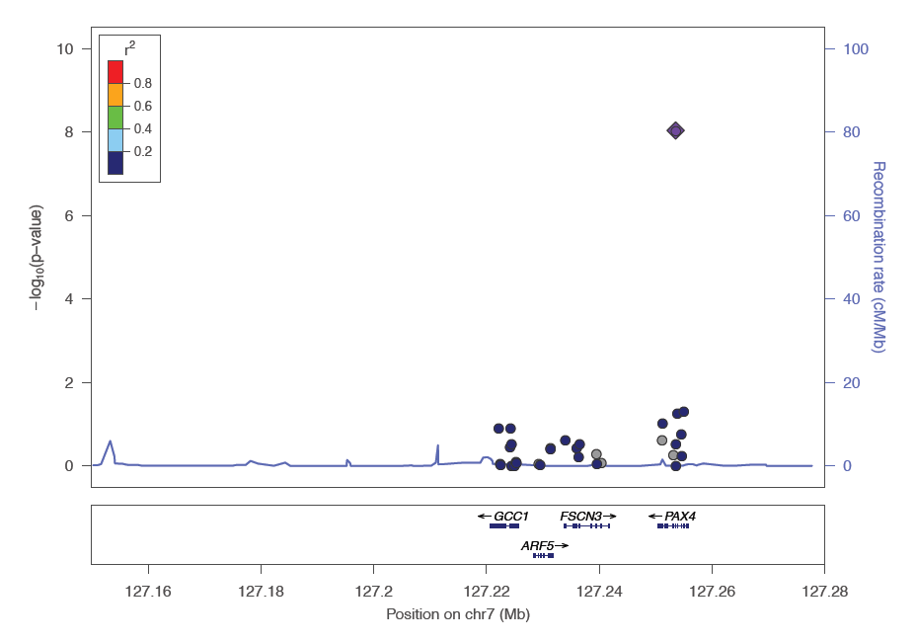
Identified PAX4 as Candidate Causal Gene
R192H
East Asian GWAS
[Cho et al. Nat Genet 2011]
variant rs6467136
GCC1-PAX4 locus
N = ~55,000
p = 5.0x10⁻¹¹
Notes:
Let’s zoom in on the PAX4 gene. This is a locuszoom plot, which similarly, plots –log10(P) against chromosome position. Each point represents a variant. We can see the gene labels at the bottom panel. The variant we found to be associated with t2d is labelled as a purple diamond. We note that a previous East Asian GWAS for t2d in 55,000 samples identified an association with a non-coding variant about 100kb away from R192H. Here, in this study, we show evidence that PAX4 is likely to be the causal gene at this locus.

Slide 41
Identified PAX4 as Candidate Causal Gene
R192H
PAX4
Role in islet differentiation and function
Mutations result in maturity onset diabetes of the young (MODY)
East Asian GWAS
[Cho et al. Nat Genet 2011]
variant rs6467136
GCC1-PAX4 locus
N = ~55,000
p = 5.0x10⁻¹¹
Notes:
PAX4 plays a role in islet differentiation and function. Mutations in this gene have been implicated in development of early-onset T2D, and maturity onset diabetes of the young (MODY)

Slide 42
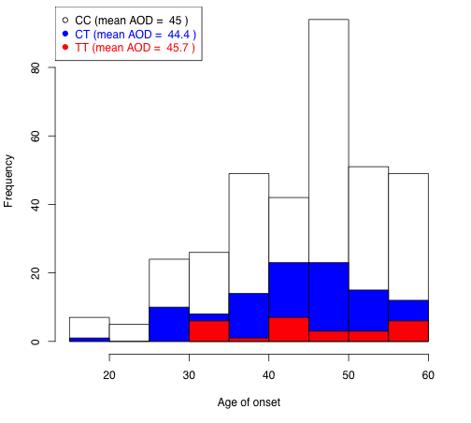
R192H replicated in other East Asian studies and not associated with age of diagnosis
Replication in additional 1,789 cases, 1,509 controls
  3 studies from Korea, Hong Kong, Singapore
  p = 6x10⁻⁷, OR = 1.47
No association between R192H and AOD in discovery or replication data (p > 0.6)
 | Mean AOD
CC | 45.0
CT | 44.4
TT | 45.7
80
60
Number of samples
40
20
0
20
30
40
50
60
Age of diagnosis (AOD)
Notes:
In order to check that this association is not driven by MODY individuals, we further check for the distribution of R192H and the age of diagnosis in the exome samples. This barplot plots the distribution of AOD in Singapore Chinese cases, with their genotype for R192H coloured in white, blue and red. We do not observe an enrichment of TT genotypes at early age of diagnosis. In three independent studies from East Asia, we furthered confirmed the association of R192H with t2d (with additional samples from SPHS), and similarly age of diagnosis is not associated with the genotype in the replication dataset. I would like to conclude the PAX4 story by mentioning that E Shyong here is leading efforts on phenotype-genotype recall, where his team re-contact the Chinese individuals who carried the PAX4 variants, and individuals who did not. These individuals are participating in physiological experiments

Slide 43
Testing for association with
T2D-related QTs in multi-ethnic exome and exome array data
Routinely test for association with T2D-associated traits such as glucose and insulin
Given phenotyping and genotyping already complete, additional analysis “free”
Association analysis of glucose, insulin in non-T2Ds
  5,108 multiethnic exome sequenced GoT2D+T2D-GENES
  33,392 Europeans genotyped with exome chip
Notes:
Glucose and insulin play an important role in t2d development.

Slide 44
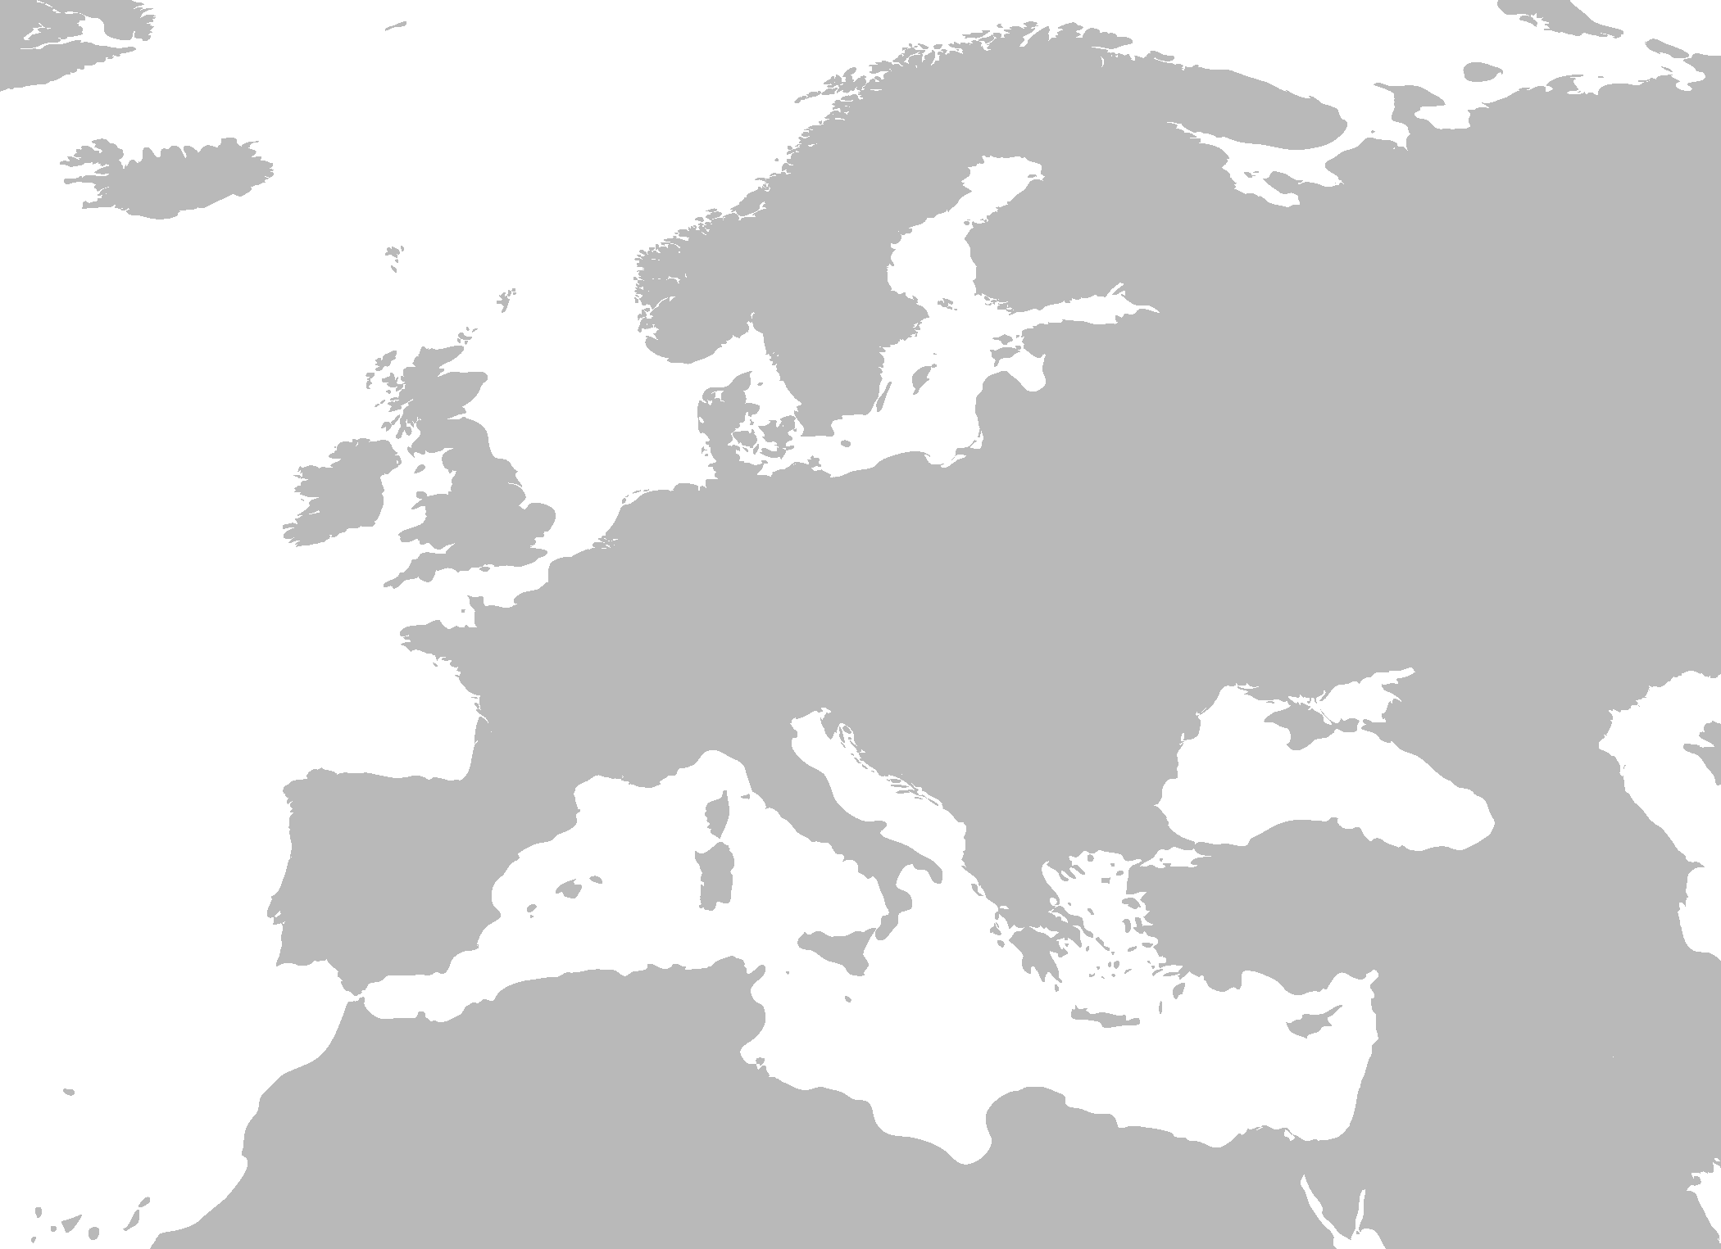
33,392 non-diabetic European individuals assayed on ExomeChip
Sweden
1,859
PIVUS/ULSAM
Finland
16,177
METSIM
PPP
FUSION
DPS
DR’s EXTRA
FIN-D2D 2007
FINRISK 2007
United Kingdom
Denmark
6,016
GoDARTS
Oxford Biobank
Twins UK
9,356
Health 2006
Inter99
Vejie Biobank
ExomeChip contains >240,000 markers focused on non-synonymous variants
Includes variants associated with complex traits in previous GWAS
Notes:
We thus set out to assay coding variant in more than 33,000 non-diabetic individuals of European descent using the ExomeChip. They are predominantly sampled from Northern Europe, in Finland, Sweden, Denmark, and the United Kingdom. The ExomeChip contains more than 240k markers focused on non-synonymous variants.

Slide 45
Rare coding variants in AKT2 associated with insulin
Gene | # variants | Mean allele frequency (%) | P_{SKAT} | P_{COLLAPSING}
AKT2 | 3 | 0.21 | 9.2x10⁻⁷ | 2.3x10⁻⁶
Notes:
Finally, a second highlight from this study is the association of gene, AKT2, with insulin in gene-level test. There are 3 variants included in the test and P50T is the main contributor to the gene-level signal. This gene, AKT2, has been linked to insulin stimulated glucose metabolism in human skeletal muscles.

Slide 46
Rare coding variant in AKT2 associated with insulin
Gene | # variants | Mean allele frequency (%) | P_{SKAT} | P_{COLLAPSING}
AKT2 | 3 | 0.21 | 9.2x10⁻⁷ | 2.3x10⁻⁶
Variant | MAF (%) | Allele count | Direction of effect (+/- FI) | Single variant P
P50T | 0.82 | 354 | + | 9.3x10⁻⁷
R208K | 0.0185 | 8 | - | 0.41
T372M | 0.00231 | 1 | - | 0.99
P50T main contributor to gene-level signal
AKT2 (v-akt murine thymoma viral oncogene homolog 2)
  linked to insulin stimulated glucose metabolism in skeletal muscle
Notes:
Finally, a second highlight from this study is the association of gene, AKT2, with insulin in gene-level test. There are 3 variants included in the test and P50T is the main contributor to the gene-level signal. This gene, AKT2, has been linked to insulin stimulated glucose metabolism in human skeletal muscles.

Slide 47
AKT2 P50T (almost) unique to Finns
Ancestry | Genotype Counts (GG/GT/TT) |  |  | MAF (%)
African American | 2,074 | 0 | 0 | 0
East Asian | 2,165 | 0 | 0 | 0
Hispanic | 1,943 | 0 | 0 | 0
South Asian | 2,217 | 0 | 0 | 0
Europeans | 26,402 | 410 | 5 | 0.78
Notes:
When we looked closer at P50T, we discovered that it is almost unique to Finnish individuals. We do not see any T allele in Non-European samples.

Slide 48
AKT2 P50T (almost) unique to Finns
Ancestry | Genotype Counts (GG/GT/TT) |  |  | MAF (%)
African American | 2,074 | 0 | 0 | 0
East Asian | 2,165 | 0 | 0 | 0
Hispanic | 1,943 | 0 | 0 | 0
South Asian | 2,217 | 0 | 0 | 0
Europeans | 26,402 | 410 | 5 | 0.78
Finns | 18,110 | 403 | 5 | 1.12
Non-Finns | 8,292 | 7 | 0 | 0.042
Notes:
When we looked closer at P50T, we discovered that it is almost unique to Finnish individuals. We do not see any T allele in Non-European samples.

Slide 49
Replication of P50T association in additional Finnish studies
Stage | Study | Effect | N | MAF (%)
Discovery | METSIM |  | 6,594 | 1.2
 | PPP |  | 4,491 | 0.9
 | FIN-D2D 2007 |  | 2,107 | 1.2
 | Pivus/Ulsam |  | 1,851 | 0.3
 | FUSION |  | 1,342 | 1.5
 | DR’S EXTRA |  | 657 | 0.8
 | FINRISK 2007 |  | 548 | 0.6
 | DPS |  | 306 | 2.3
 | Exomes (Europeans) |  | 1,673 | 0.7
Replication | Young Finns Study |  | 1,958 | 1.3
 | GenMets |  | 1,894 | 1.0
 | Helsinki Birth Cohort Study (HBCS) |  | 1,611 | 0.9
 | FINRISK 1997 & 2002 |  | 370 | 1.0
Beta [95% CI]
Fixed Effect Model 0.28 [0.19; 0.37]
P_{combined} = 1 x 10^{-­9}
Notes:
As this variant is almost exclusively present only in Finns, we sought replication of the association in 4 independent Finns studies. In four independent Finnish studies, with total sample size of almost 6,000, the association trended in the same direction, with allele frequency between 0.9% and 1.3%. Together with the discovery samples, we have a combined meta-analysis p-value of 1.0e-9. One of the studies, METSIM, showed the strongest association signal and has ~7000 Finnish samples. Markku Laakso is also performing phenotype-genotype recall and physiological work on these carriers.

Slide 50
Comments: AKT2
Rare AKT2 mutations cause monogenic disorders of insulin signaling
P50T nearly Finland-specific
Conditioning on P50T does not reveal additional association signals in the region
Markku Laakso soon to begin callback of variant carriers and homozygotes in METSIM study for additional phenotyping

Slide 51
Current Directions for FUSION
Genotype-based phenotype follow-up in carriers of likely loss-of-function variants:
  Kuopio, Finland as part of METSIM study
  UM as part of Michigan Genomics Initiative
Expression study in 331 individuals who provided muscle, adipose, and skin samples and extensive phenotype data
Continued sequencing and genotyping studies and meta-analyses

Slide 52
Summary and Comments
>90 common variant risk loci identified for T2D, 100s for T2D-related QTs (>60 for glucose/insulin)
Sequencing, rare-variant genotype arrays allow us to explore the full allele frequency spectrum
Model of (many) rare variants of large effect unlikely for T2D
Associated common variants largely consistent across ancestries; associated low frequency variants often distinct across different ancestries
Collaboration critical to success

Slide 53
Acknowledgements
Michigan: L Scott, G Abecasis, T Teslovich, HM Kang, X Sim, G Jun, C Fuchsberger, A Locke, J Huyghe, R Welch, C Ma, H Stringham, A Jackson, T Blackwell
More FUSION/CIDR/METSIM: K Mohlke, M Laakso, F Collins, J Tuomilehto, R Bergman, L Bonnycastle, P Chines, M Erdos, M Morken, N Narisu, A Swift, R Watanabe, K Doheny, E Pugh
Oxford/Lund: D Altshuler, L Groop, R Saxena, B Voight, N Burtt, S Gabriel, J Flannick, A Manning, P Fontanillas, A Williams, E Banks, C Hartl
Oxford/Exeter: M McCarthy, A Morris, A Hattersley, K Gaulton, P Donnelly, C Lindgren, I Prokopenko, L Moutsianis, A Mahajan, T Ferreira, S Wiltshire, W Rayner, J Perry
Munich: Thomas Meitinger, Tim Strom
More T2D-GENES: R Duggirala, J Blangero, C Hanis, N Cox, G Bell
Funding from NIDDK, NHGRI, ADA, Wellcome Trust

