Slide 1
Estimates of Genetic Ancestry
Sequence Analysis Workshop May 2015
University of Michigan

Slide 2
Take-Home Points
Allele frequencies differ between populations.
These difference cause confounding.
Using “population” as covariate may control such confounding.
Population can be estimated from genetic data.
Low coverage data can be used with specialized methods.

Slide 3
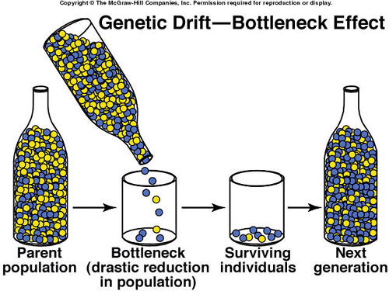
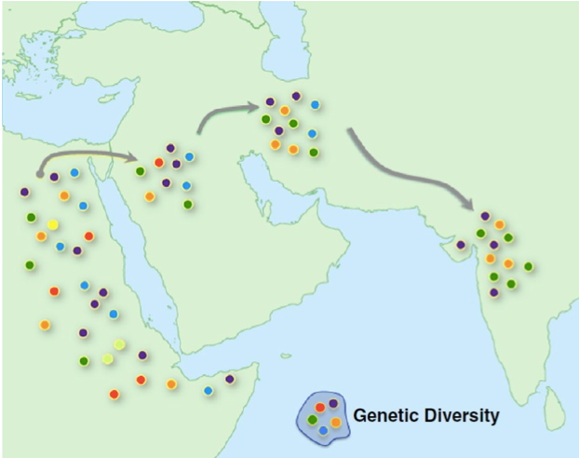
Sequence of Bottlenecks
National Geographic

Slide 4
Isolation by Distance

Slide 5
Assortative Mating

Slide 6
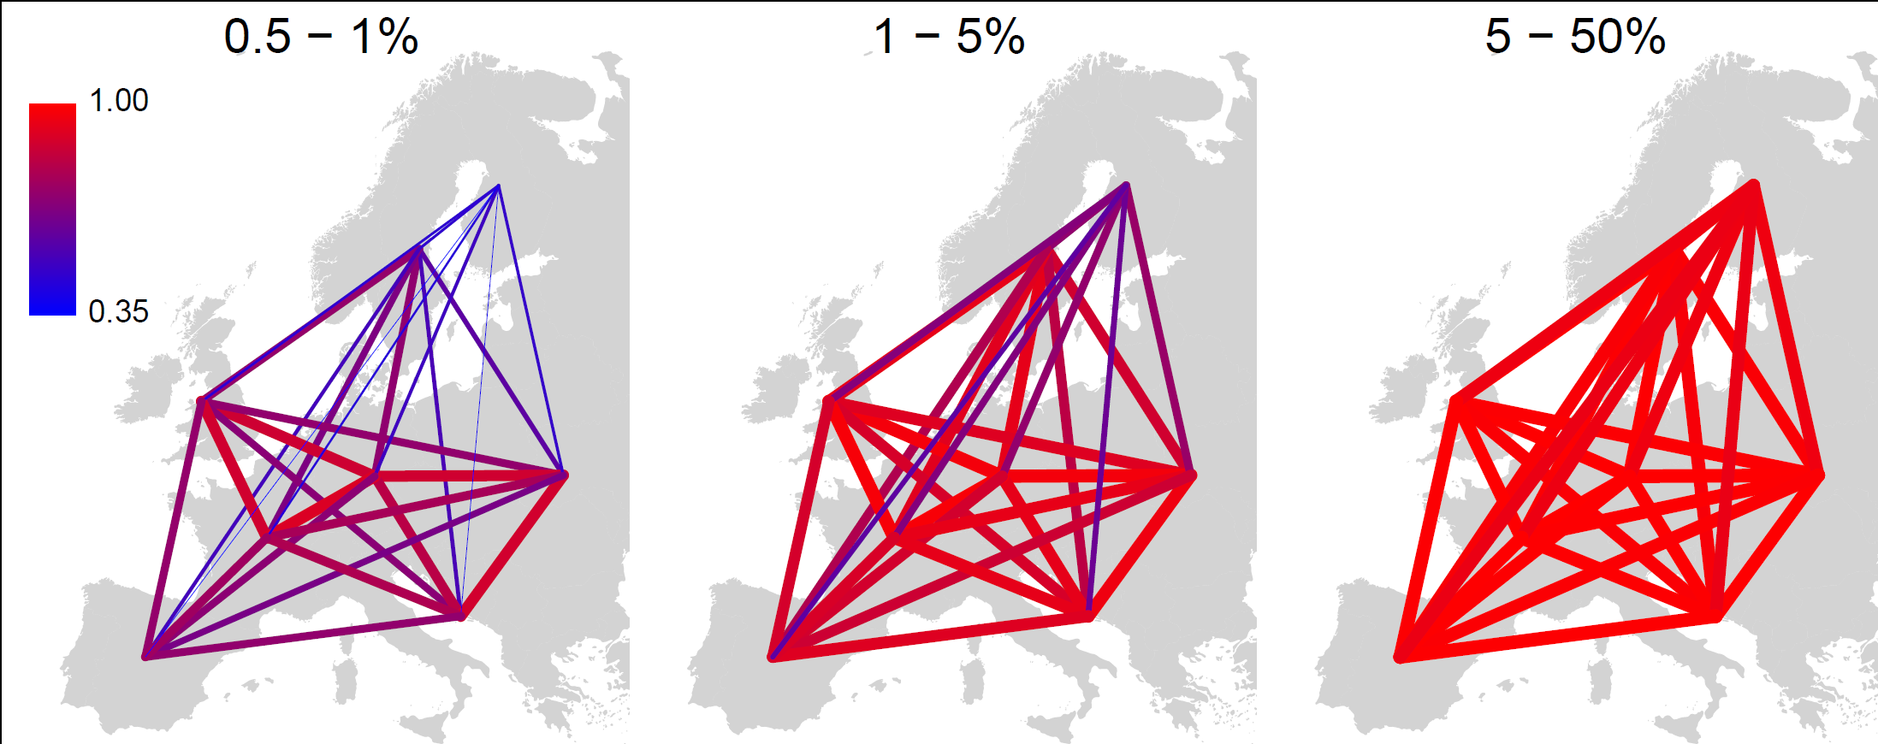
Rare Varaints in Europe
Median EU-EU: 0.71
Median EU-EU: 0.86
Median EU-EU: 0.98
EU
EU
EU
0.23
0.33
0.22
0.48
0.61
0.90
AA
AS
AA
AS
AA
AS
0.19
0.19
0.63
Notes:
To-do:
Sharing nubmers in middle panel are for (1,2.5]% but plot is for 1-5%
Move to world map…

Slide 7
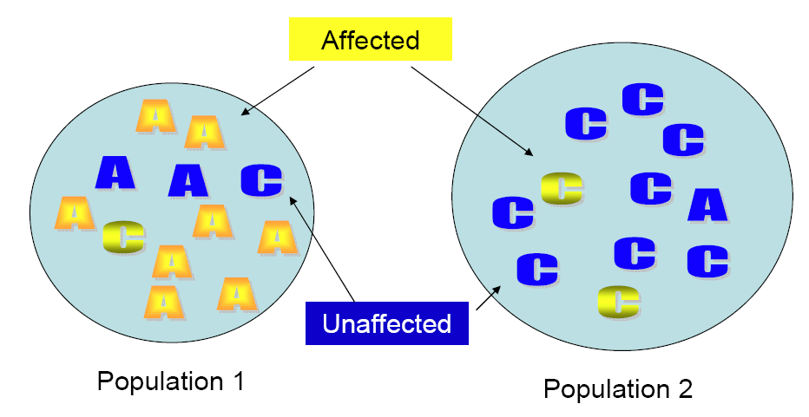
Stratification
Stratification occurs in the following scenario:
The phenotype is more common in one population.
Allele frequencies are different between populations.

Slide 8
Stratification causes association
If prevalences differ between populations, every marker with differing allele frequencies will be associated to the disease. this creates a lot of false positives.
Not accounting for stratification can reduce the power to detect associated variants.
A
A
C
C
Cases
Controls

Slide 9
ABO causes everything
Between 1950-60 a lot of traits were associated with the ABO blood group:
Cancer of the stomach
Gastric Ulcer
Diabetes Mellitus
Salivary tumors
Fracture of the neck and femur
All the results were caused by stratification

Slide 10
Detecting stratification
Hardy-Weinberg Equilibrium
Not very powerful; confounded with QC
LD of unlinked markers
For example ancestry-informative markers
q-q plot

Slide 11
Good q-q plot
Willer et al, Nature Genetics, 2008

Slide 12
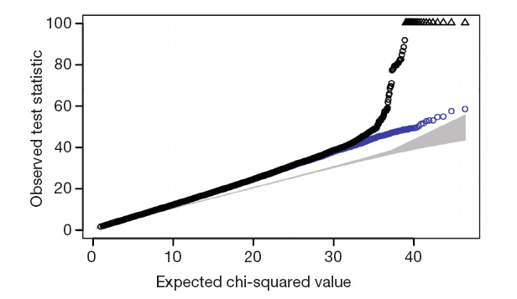
Bad q-q plot
WTCC
Nature (2007) 447:661-78

Slide 13
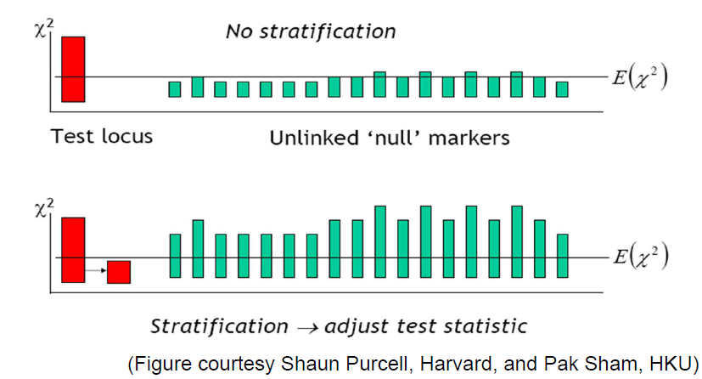
Genomic Control - Concept

Slide 14
Genomic Control
Select al pairs of unlinked markers (pairwise distance >100kb)
Compute chi-squared for each marker
Inflation factor λ
Average observed chi-squared
Median observed chi-squared / 0.456
Should be >= 1
Adjust statistic at candidate markers
Replace χ²_{biased} with χ²_{fair} = χ²_{biased}/λ
λ also provides a convenient way to summarize magnitude of stratification.

Slide 15
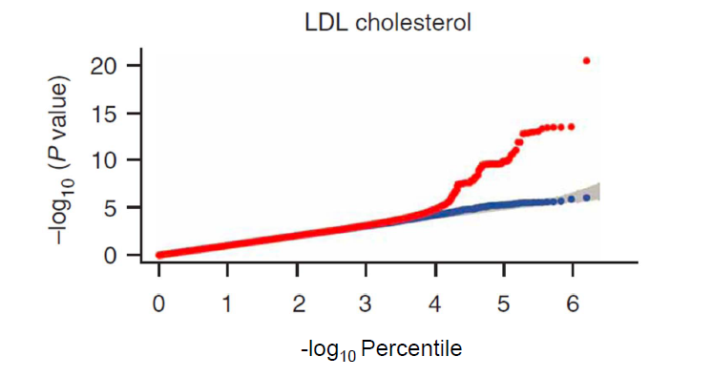
GC as diagnostic
The genomic control value examines markers with little evidence for association. If these large p-values were to deviate from expected, there is a problem! In this case, λ=1.02.

Slide 16
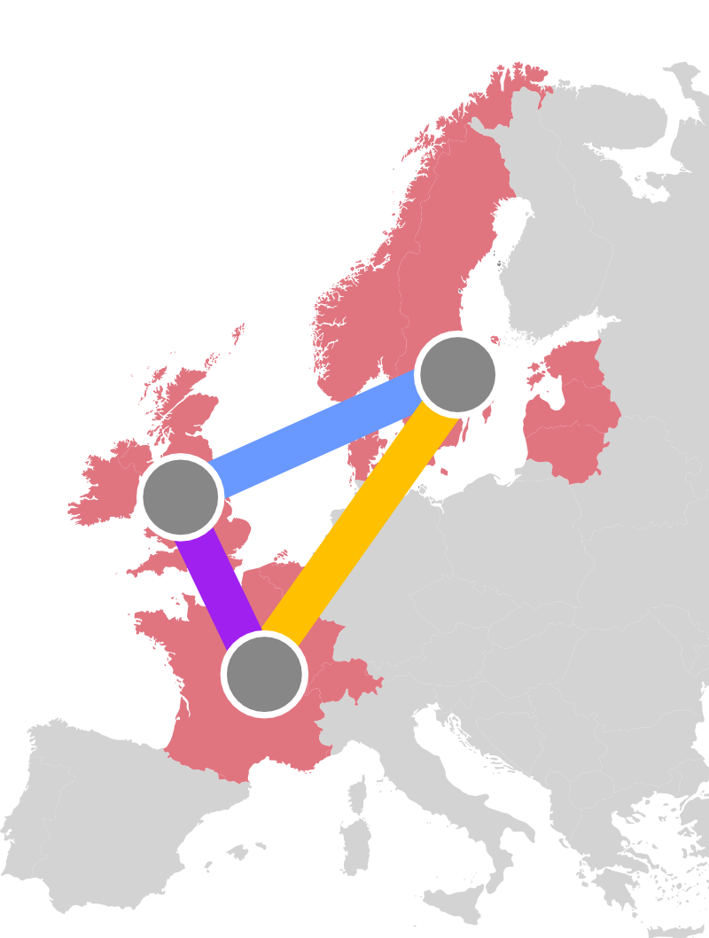
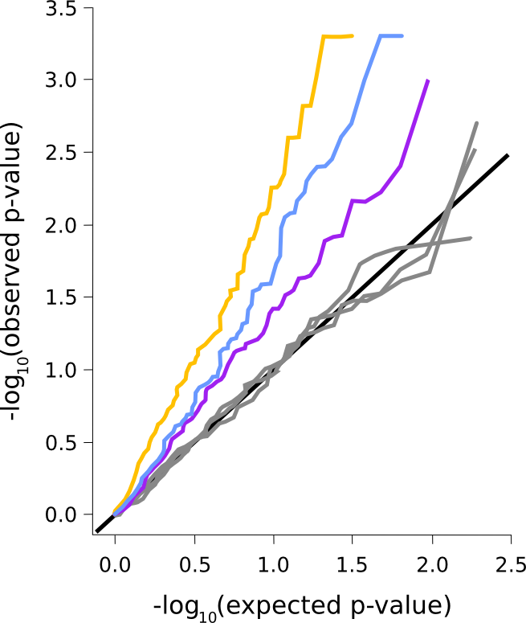
Stratification in Burden Tests
QQ-plot rare variant burden test (CMAT)
λ₅₀ is inflation of the median p-value.
(Devlin and Roeder, 1999)
Strongly inflated type I error in all cross-population comparisons
(n=900/900, MAF < 1%, Nonsense/nonsynonymous variants)
Notes:
Test is symmetric…
Add in lambda values…
but note that genomic control lambda not enough to correct – b/c effect depends on total # of variants per gene… so per-gene correction factors needed. Likely to overcorrect genes that have small variation.

Slide 17
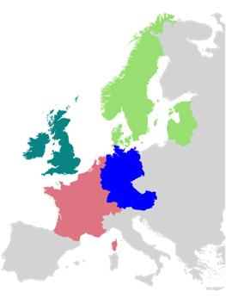
General Evaluation of Stratification
Select 2 populations.
Select case contribution.
Sample 30 variants from the 202 genes.
Calculate inflation based on observed frequency differences.

Slide 18
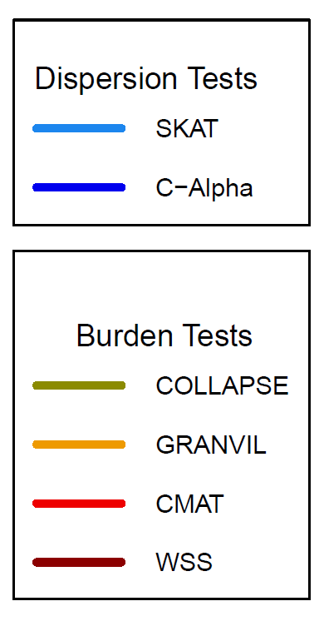
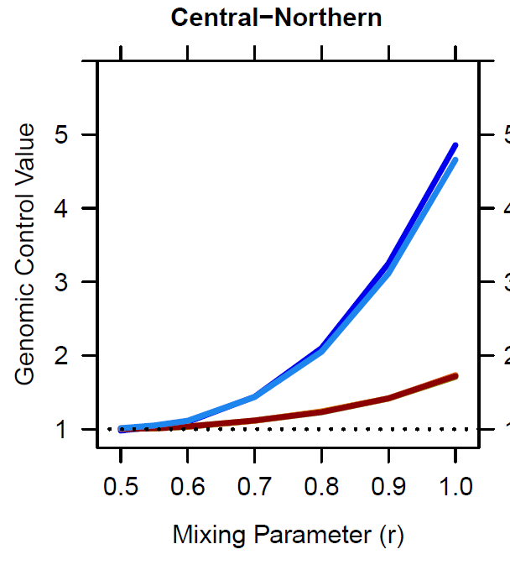
Inflation by Mixture Proportion
Zawistowski et al. 2014

Slide 19
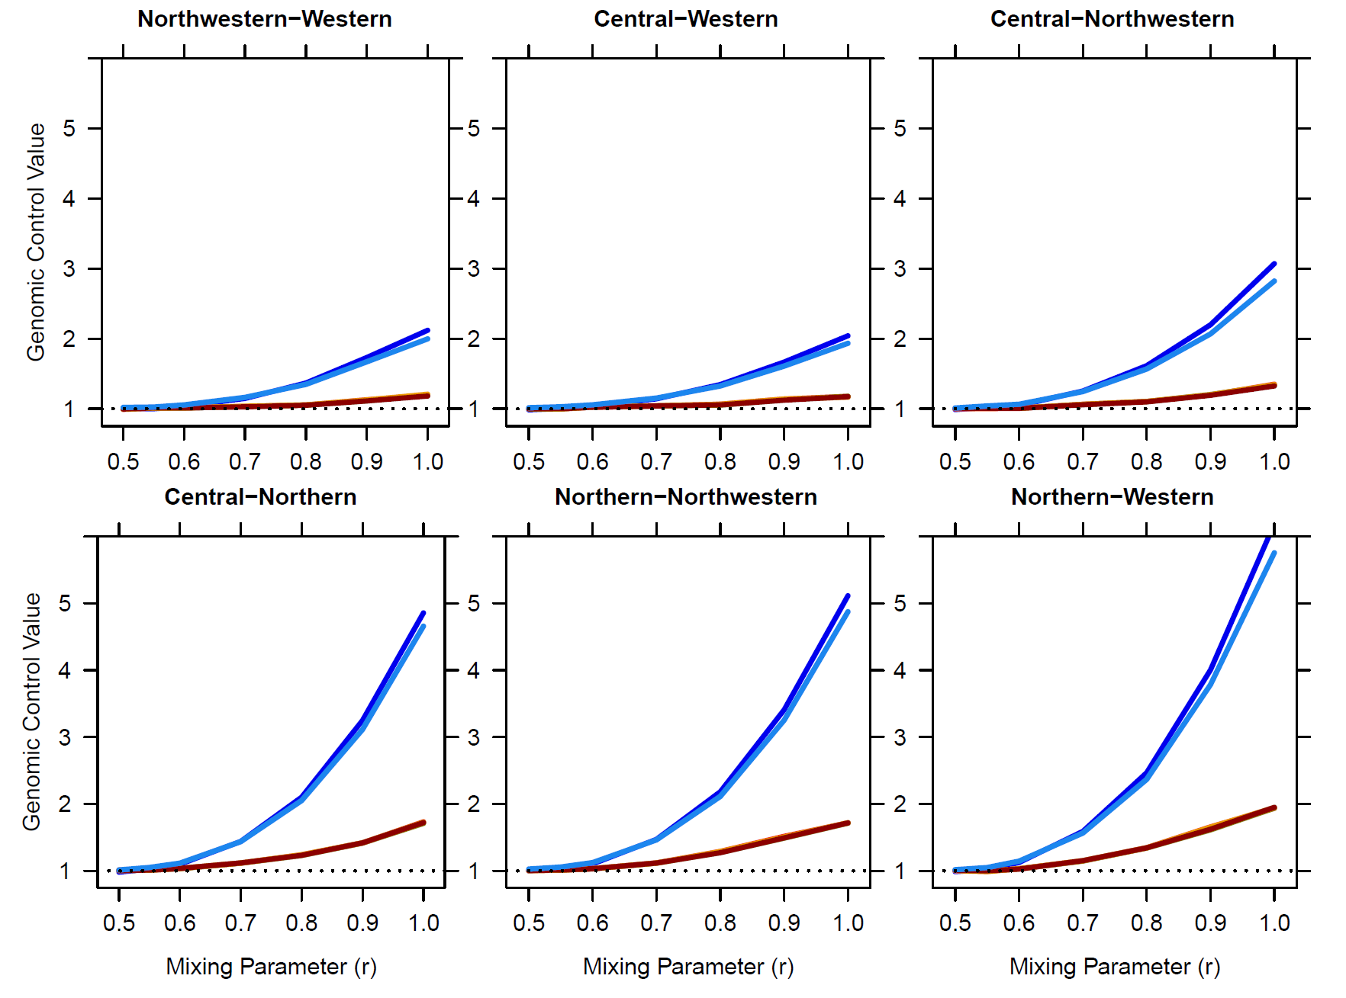
Inflation across Comparisons

Slide 20
Controlling for Stratification
Careful sampling (often not sufficient)
Family-based controls
Consider markers from the Null
Ancestry- informative markers
GWAS provides 300,000+ datapoints from the Null.
Genomic control
Structured association
PCA

Slide 21
Why Genomic Control
Simple and convenient approach…
Easily adapted to other test statistics, such as those for quantitative trait and haplotype tests
However:
Stratification does not always inflate p-value under the alternative.
Results in extra loss of power.
Not appropriate for gene –based tests.

Slide 22
Estimating Population Structure
Available data is high-dimensional (thousands of makers).
Populations can be modeled as categories or as a continuum.
Population can be used as covaraite.
It is not clear that population structure is the same for common and for rare variants.

Slide 23
Model-based clustering
STRUCTURE/ADMIXTURE/FRAPPE
Consider a set of markers
Model allele frequencies of (pre--‐specified) K discrete clusters
Optimal for AIMs
Computationally challenging for large datasets
Not suitable for continuous population structure

Slide 24
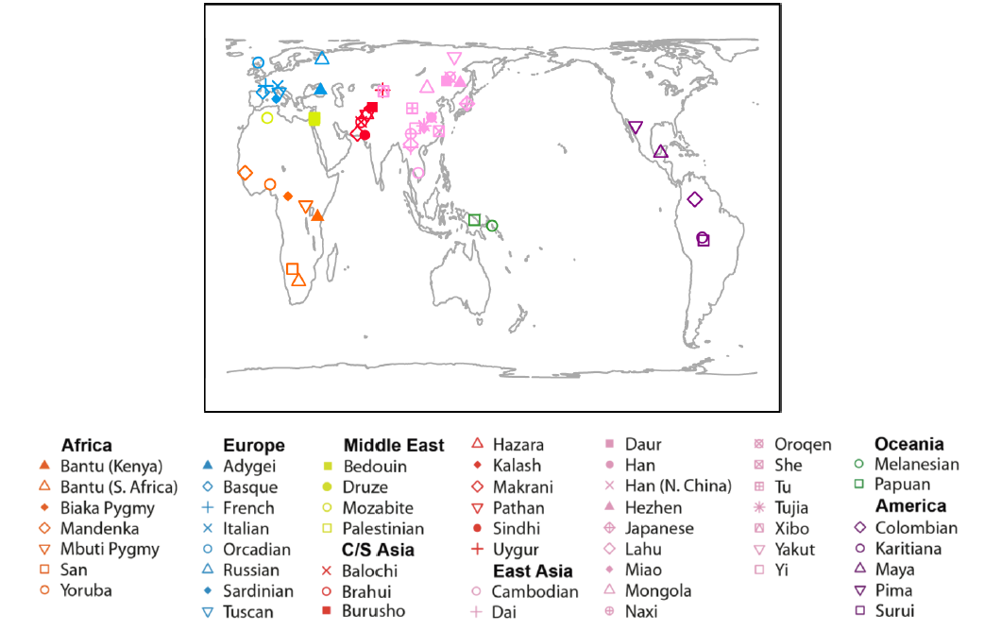
Human Genome Diversity Panel

Slide 25
Results allows for other interpretations
Rosenberg et al, Science, 2002)

Slide 26
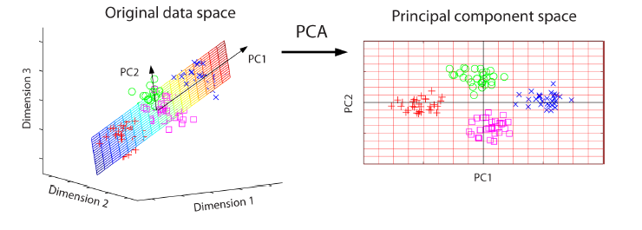
Principle Component Analysis
Model each genotype as quantitative variable
Number of copies of the minor allele
Identify small number of principal components (PC)
Linear combinations of observed genotype scores
Selected to explain variation in genotype scores
Typically, one to ten PC are modeled
Allow population structure to be visualized
Can be used as covariates in association analysis

Slide 27
Principle Component Analysis
Principal component analysis (PCA) uses an orthogonal transformation to convert a set of observations of possibly correlated variables into a set of values of uncorrelated variables called principal components.
To perform the PCA, the matrix of k genotypes in n individuals is first normalized by
Eigenvectors and Eigenvalues are calculated by singular value decomposition.
“Large” Eigenvalues indicate that the corresponding Eigenvector reflects nonrandom population stucture.

Slide 28
World-wide PCA
Li et al. (2008) Science; Jakobsson et al. (2008) Nature

Slide 29
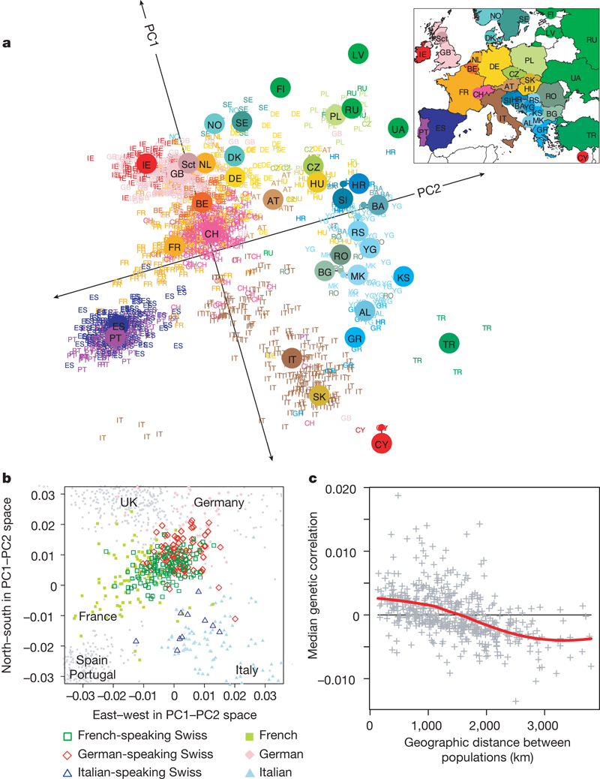
PCAs capture geographic structure
Population structure within Europe.
J Novembre et al. Nature (2008)

Slide 30
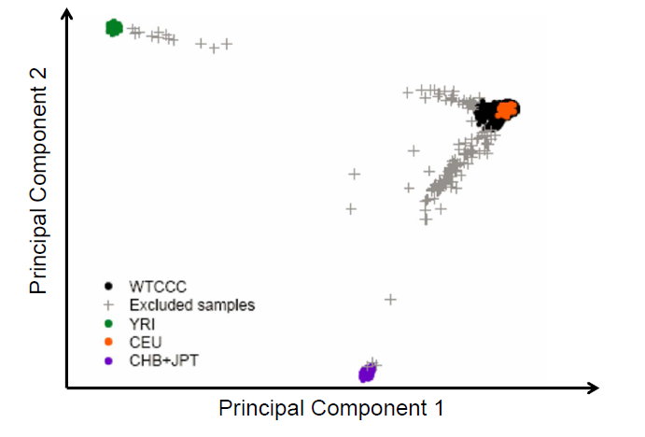
Application to a GWAS
WTCCC, Nature, 2007

Slide 31
Potential Pitfalls in PCA
Including individuals of known geographic origin can help interpretation.
LD is a major correlation structure in genomic data. Large regions of correlated markers can have their own Eigenvectors. This can be controlled by checking the loading of all Eigenvectors.
Related Individuals will have their own Eigenvector.
Outlier distort smaller Eigenvectors. Analyses should be performed multiple times, to detect and remove outliers and a final time to infer structure in the remaining population.

Slide 32
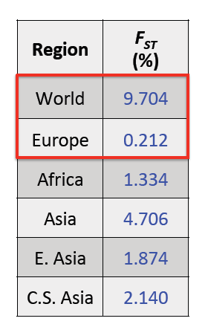
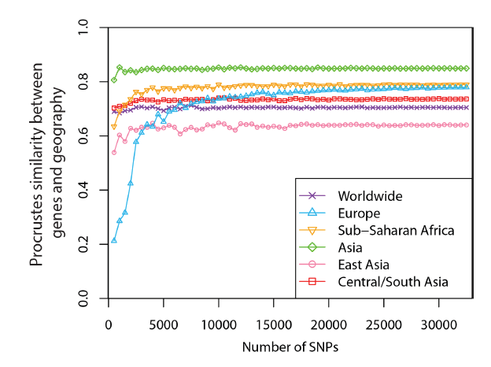
How many markers are needed?

Slide 33
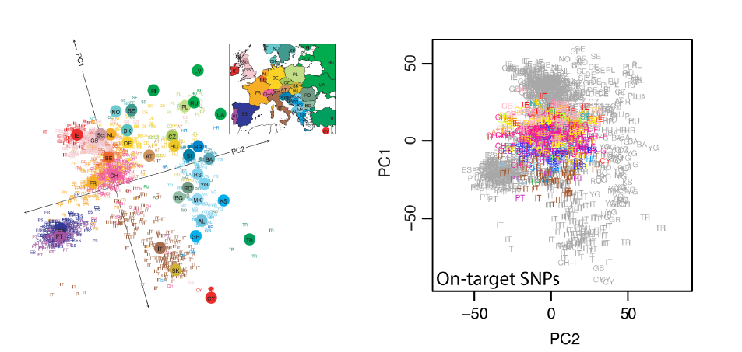
What happens if we have too few markers?
2,547 SNPs in POPRES data overlapped with whole exome sequencing

Slide 34
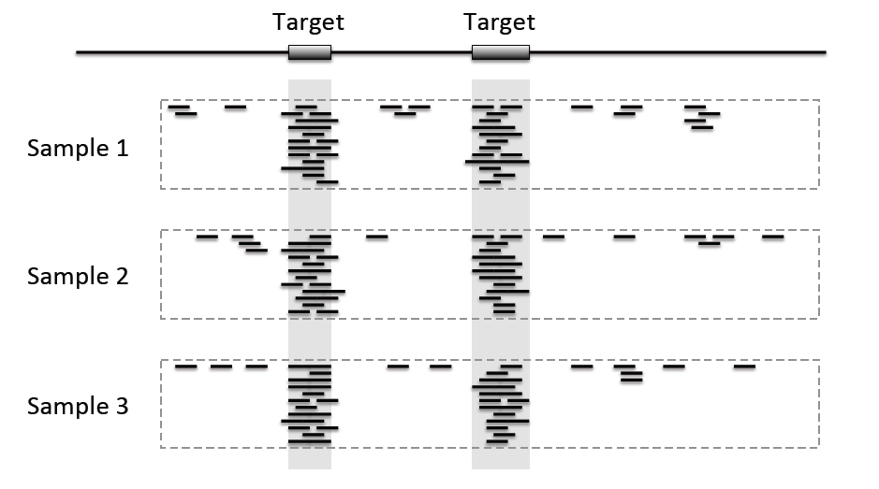
What about off-target reads?

Slide 35
LASER: Locating Ancestry from Sequence Reads
Traditional methods such as PCA cannot be directly applied on off-­‐target sequencing data.
Genotype uncertainty
Large amount of missing data
The LASER method:
Use off-­‐target sequence reads to place sequenced samples one by one into a reference PCA map of ancestry
Directly analyze sequence reads without calling genotypes
Analyze each sample with a set of reference individuals

Slide 36
Data used in LASER
Study samples: low-coverage sequencing reads sparsely distributed across off-target regions.
Reference samples with known ancestry: high- quality genome-wide SNP data.
Human Genome Diversity Panel (HGDP)
938 individuals from 53 worldwide populations
632,958 autosomal SNPs after QC
Li et al.(2008) Science
Population Reference Sample (POPRES)
1,385 individuals from 37 European populations
318,682 autosomal SNPs after QC
Novembre et al. (2008) Nature

Slide 37
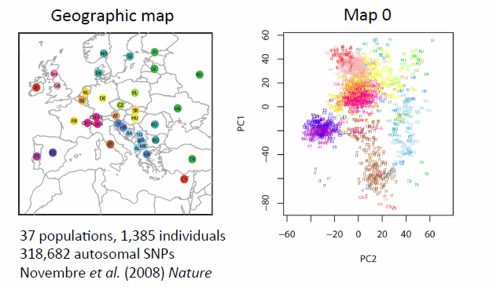
Step 1: Generate Reference map with PCA

Slide 38
Step 2: Adjust the reference
Consider a sample i with coverage C_{ij} at locus j. Let e be the error rate.
Simulate sequence data for all reference individuals at site j assuming coverage C_{ij}.
Count the number of non-reference reads at each position

Slide 39
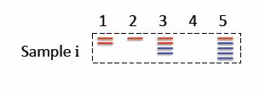
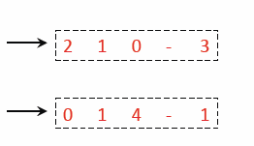
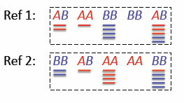
Example
1 Individual, 5 sites
Coverage varies from 0x to 5x
2 reference Individuals
Simulated coverage identical to sample i.

Slide 40
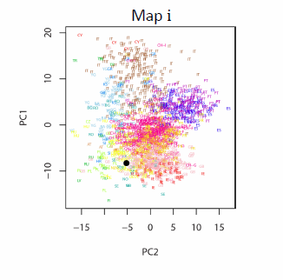
Step 3: Perform PC on new data

Slide 41
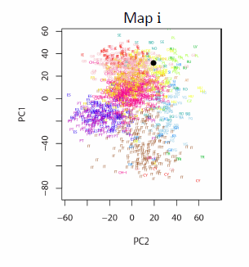
Step 4: Map on Reference Map

Slide 42
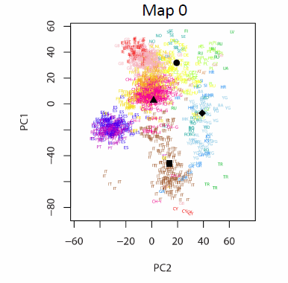
Repeat

Slide 43
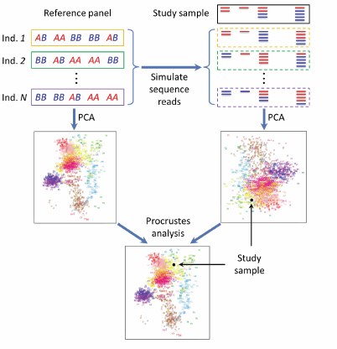
All together
Wang et al. (2014) Nat Genet.

Slide 44
Evaluation in World-Wide Sample

Slide 45
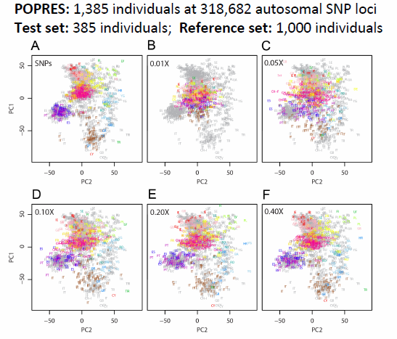
Evaluation in European Sample

Slide 46
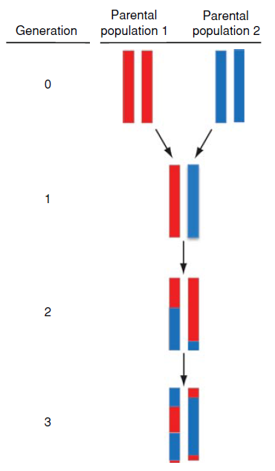
What about Local Ancestry?
In admixed individuals, ancestry contributions differ along the genome.
The ancestry at a locus can be an important covariate for analysis.
Example: an African-American is expected to have genome-wide 20% and 80% of European and African ancestry, respectively.
1 copy of each parental population
2 copies of parental population 2
Shriner D. (2013)

Slide 47
Methods to Infer Local Ancestry
Window-based
make ancestry predictions within short (overlapping) windows and then combine the results
Hidden Markov Model
True underlying local ancestry is the hidden state
Use observed genotype to infer the local ancestry
Combing the information from neighboring loci

Slide 48
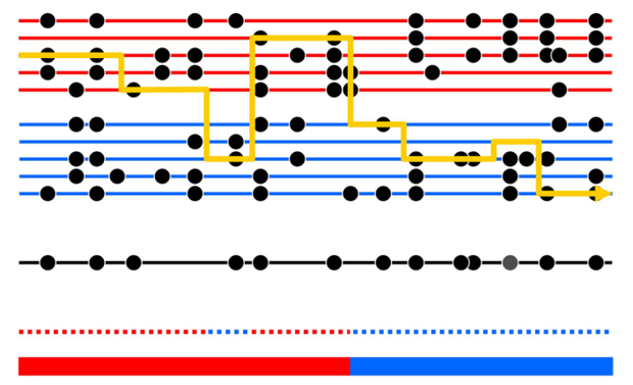
HMM to Infer Local Ancestry
Price et al. (2009)
Notes:
However, setting these parameters equal
to zero is likely to lead to spurious ancestry breaks, and therefore
misestimation of ancestry segments, for at least two reasons. First,
because we only sample a finite number of parental chromosomes,
incomplete lineage sorting can occur. In some parts of the genome,
the offspring chromosome is expected to have a deep coalescence
time with the ancestors of the ‘‘correct’’ parental sample, and may
instead coalesce first with an ancestor of the other parental sample –
and therefore choose a descendant of this ancestor, in the ‘‘wrong’’
parental sample, to copy from. Second, if our reference populations
are somewhat inaccurate relative to the true ancestral populations,
again it is likely that incomplete lineage sorting will occur, even if
our ‘‘parental’’ samples are both large.

Slide 49
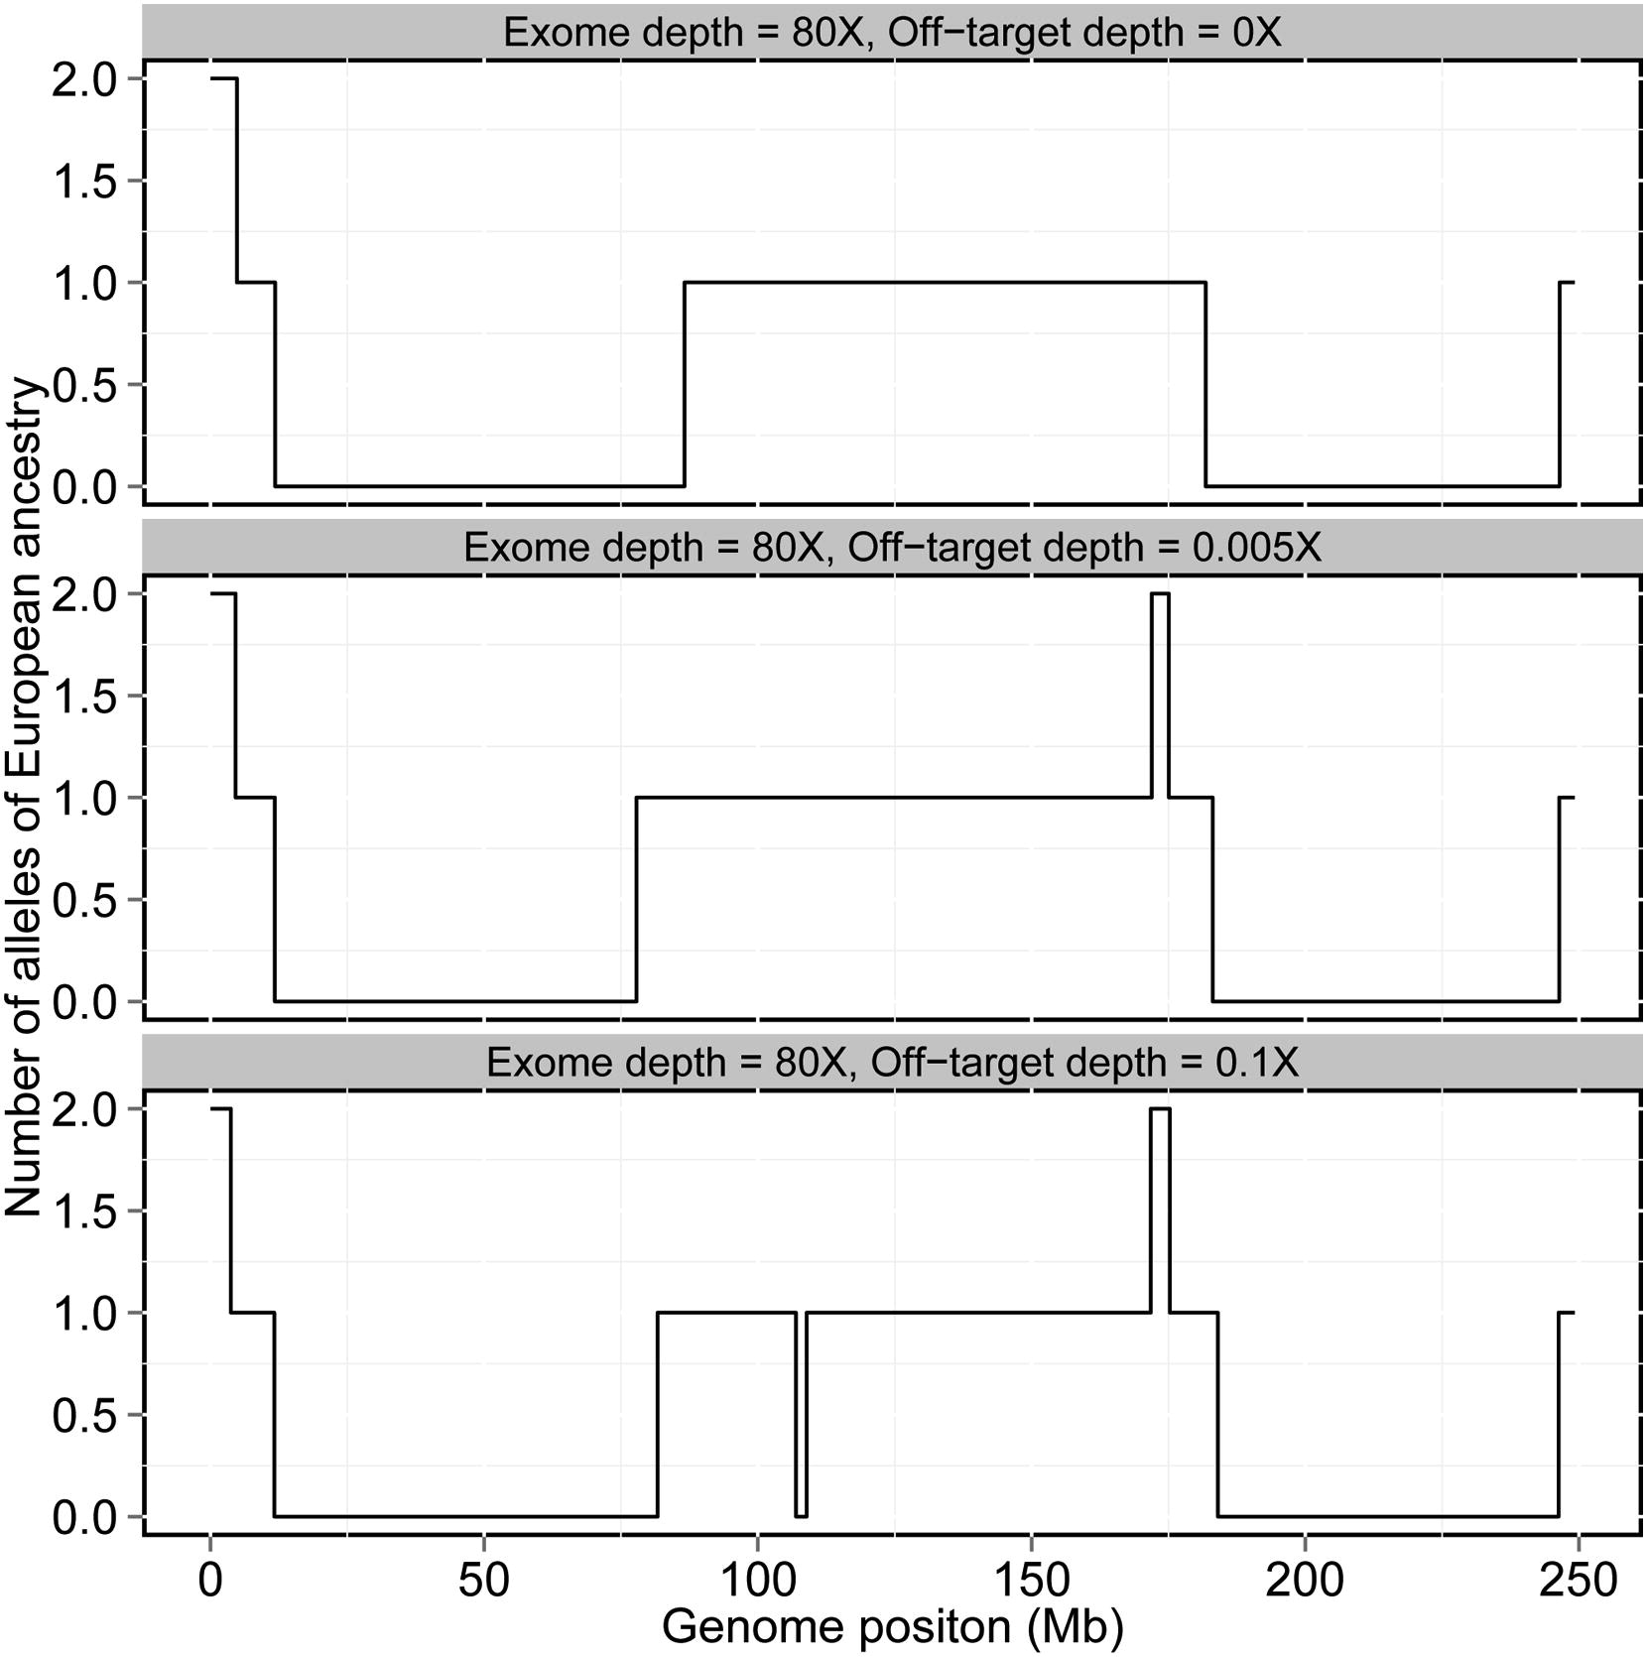
HMM estimate
Notes:
Figure 7. Local ancestry estimates produced by HAPMIX for three real Mozabite individuals on chromosome 1. The plots are
constructed as for Figure 5, and show HAPMIX estimates of the number of sub-Saharan African copies across chromosome 1 for three individuals
chosen for having different genome-wide African ancestries: 20% (top plot), 29% (middle plot) and 75% (bottom plot). The top plot looks similar to
Figure 5, while the much longer segments seen in the two individuals with more African ancestry indicate more recent admixture with sub-Saharan
Africans.

Slide 50
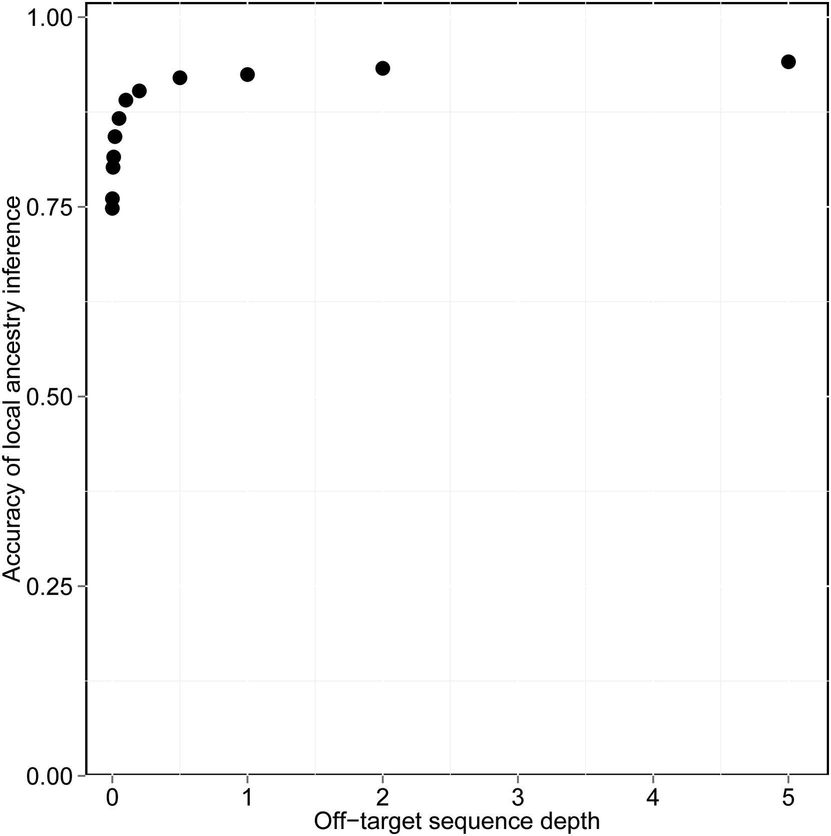
Benefit of off-target coverage

Slide 51
Take-Home Points
Allele frequencies differ between populations.
These difference cause confounding.
Using “population” as covariate may control such confounding.
Population can be estimated from genetic data.
Low coverage data can be used with specialized methods.

