Slide 1
Genetic Association Analysis
Clement Ma
Sequence Analysis Workshop
May 21, 2015
Lecture slides adapted from Hyun Min Kang and Gonçalo Abecasis

Slide 2
Outline
Introduction
Data overview
Analysis of common variants
Analysis of low-frequency variants

Slide 3
Introduction
Genetic Association Analysis

Slide 4
Genetic association studies
Goal: Identify genetic variants associated with diseases and traits
Why?
  Improve understanding of genetic mechanisms underlying diseases and traits
  Identify potential drug targets for new therapies
  Screen individuals with high risk for disease

Slide 5
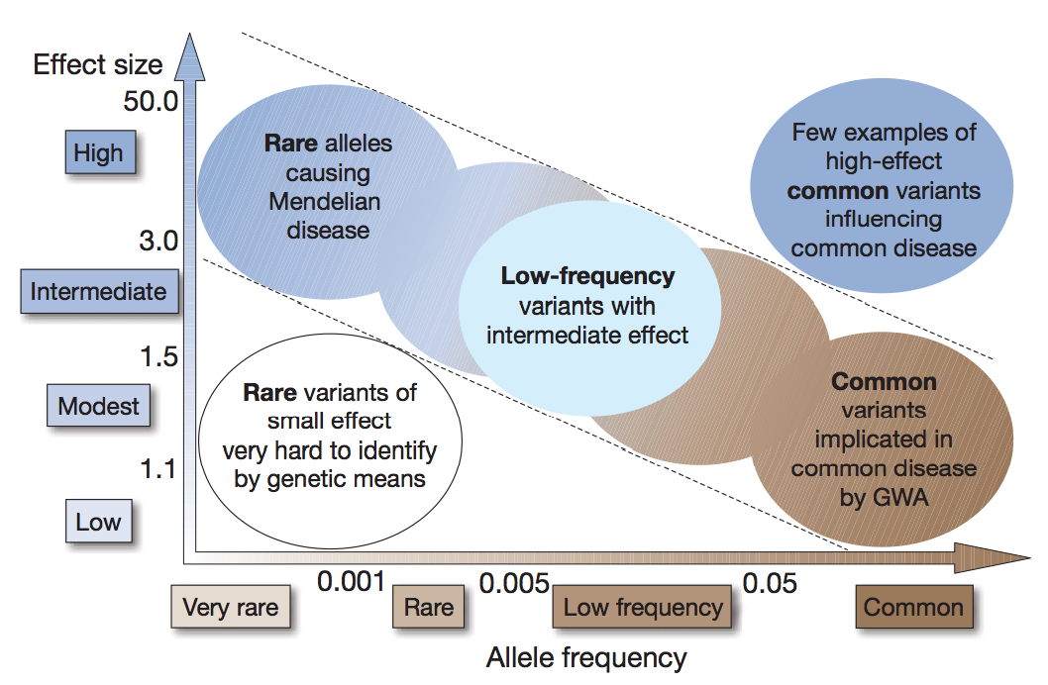
Genetic architecture of complex traits

Slide 6
Genetic architecture of complex traits
Array-based genotyping

Slide 7
Genetic architecture of complex traits
Population sequencing,
Dense reference imputation into GWAS,
Specialized array genotyping

Slide 8
Genetic architecture of complex traits
Family-based Sequencing
Array-based GWAS?
Deep Genome with
Very Large Samples?

Slide 9
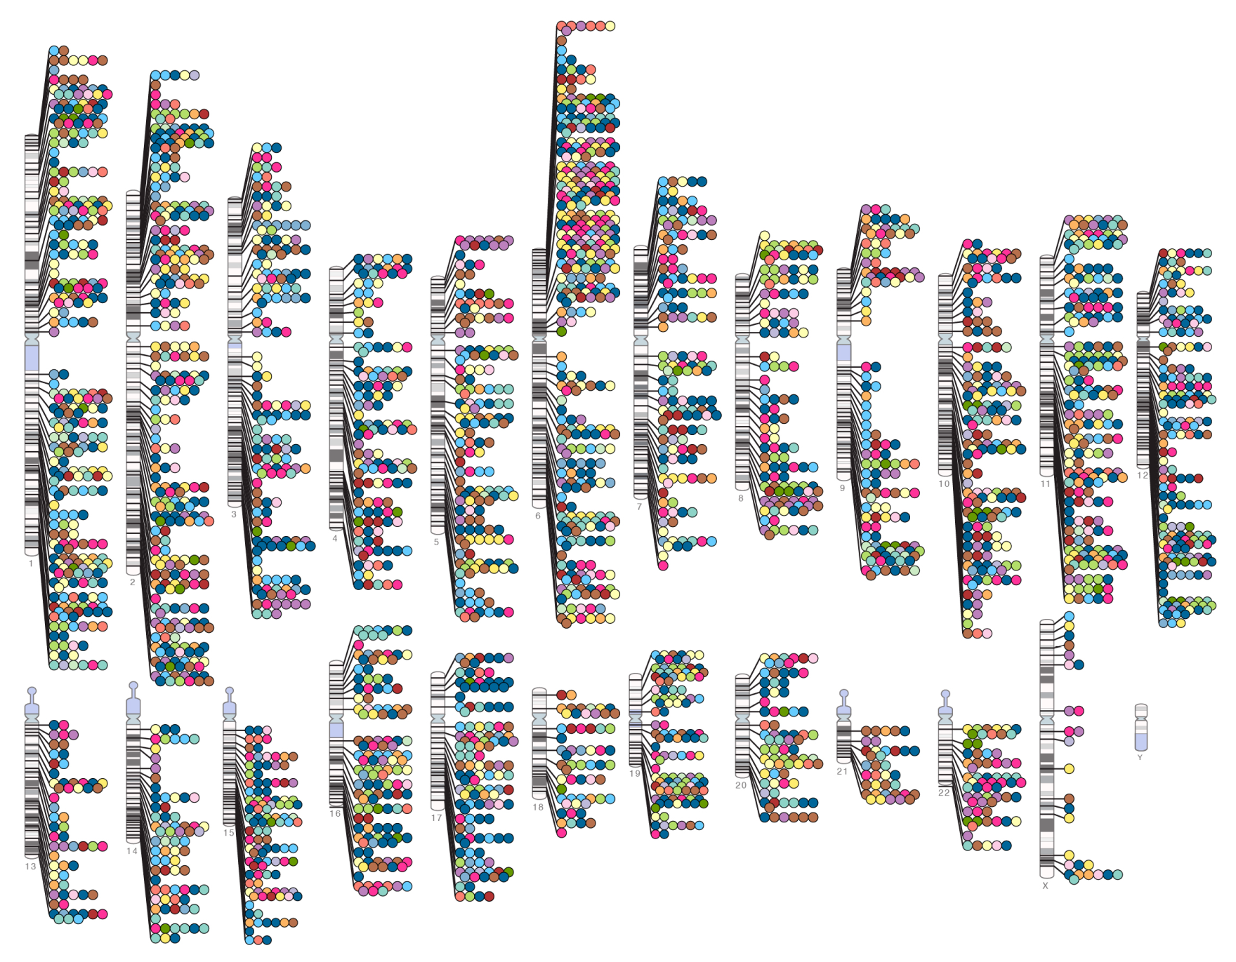
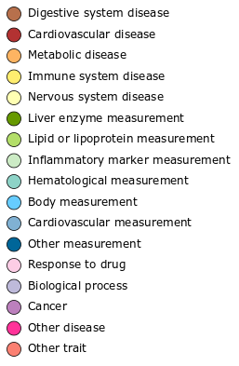
Genotype array-based GWAS identified thousands of associated variants
Published G-W significant associations
(p ≤ 5x10⁻⁸) as of 12/2012
NHGRI GWA Catalog: http://www.genome.gov/GWAStudies/

Slide 10
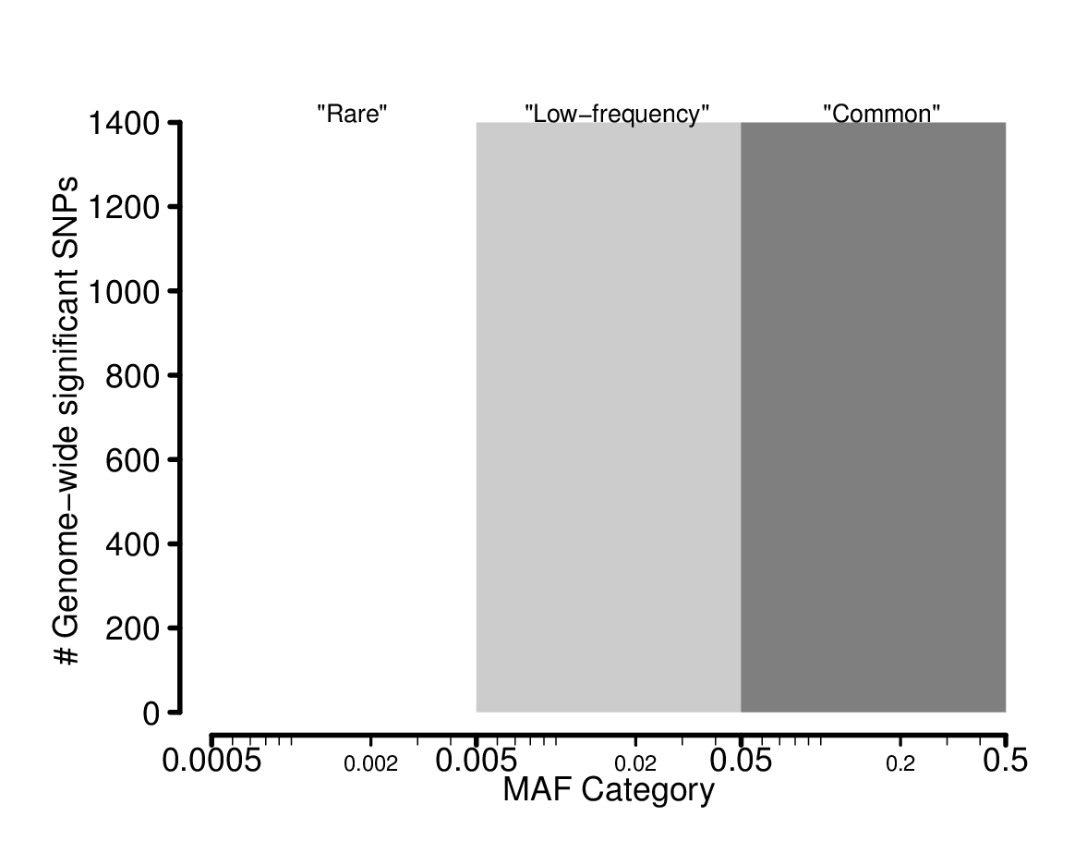
Genome-wide significant SNPs by MAF
5,783 SNPs from GWAS Catalog with p≤5x10⁻⁸

Slide 11
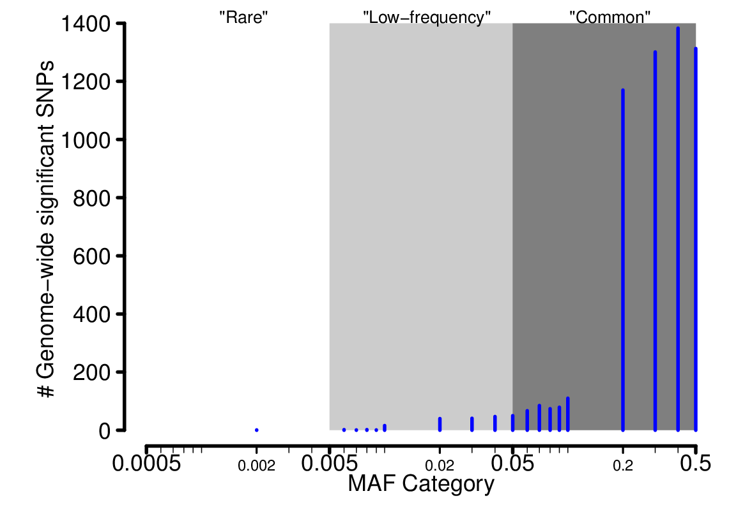
Genome-wide significant SNPs by MAF
5,783 SNPs from GWAS Catalog with p≤5x10⁻⁸

Slide 12
Genome-wide significant SNPs by MAF
Common associated variants:
Have small effect sizes
Explain modest proportion of total genetic heritability
5,783 SNPs from GWAS Catalog with p≤5x10⁻⁸

Slide 13
Genome-wide significant SNPs by MAF
  Low-frequency and rare associated variants may:
  Have larger effect sizes
  Explain larger proportion of trait heritability
5,783 SNPs from GWAS Catalog with p≤5x10⁻⁸

Slide 14
Data Overview
Genetic Association Analysis

Slide 15
Phenotypes: binary trait
Y
1
0
1
1
0
…
0
Cases = 1
Controls = 0
n individuals

Slide 16
Phenotypes: quantitative trait (QT)
Y
0.08
0.84
0.17
0.19
0.35
…
1.39
Transf.(Y)
-2.5
-0.2
-1.8
-1.7
-1.0
…
0.3
n individuals
Transformation:
Logarithm
Inverse normal
Freq.
Freq.
Y
Transf.(Y)

Slide 17
Genotypes: hard genotypes
m markers (SNPs)
g₁ | g₂ | g₃ | g₄ | … | g_{m}
2 | 0 | 1 | 0 |  | 2
0 | 1 | 0 | 0 |  | 1
0 | 1 | 1 | 0 |  | 2
1 | 2 | 0 | 0 |  | 2
0 | 1 | 1 | 0 |  | 1
… | … | … | … |  | …
1 | 0 | 2 | 0 |  | 0
n individuals

Slide 18
Genotype imputation
Aside
Goal: to increase power by using previously genotyped GWAS samples
Problem: GWAS samples genotyped at fewer or different variant sites
Method: Use genotype imputation to fill in missing genotypes
(Marchini et. al., Nat. Genet., 2007; Li et. al. Genet. Epidemol., 2009)

Slide 19
Using genotype imputation to fill in missing genotypes
Aside
1. Starting Data
Genotyped sample
. | . | C | . | . | G | . | C | .
Reference haplotypes
A | G | A | T | C | T | C | C | T
A | G | C | T | C | T | C | A | T
A | G | A | T | C | G | C | C | T
A | G | A | T | C | T | A | C | T

Slide 20
Using genotype imputation to fill in missing genotypes
Aside
2. Identify shared regions of chromosome
Genotyped sample
. | . | C | . | . | G | . | C | .
Reference haplotypes
A | G | A | T | C | T | C | C | T
A | G | C | T | C | T | C | A | T
A | G | A | T | C | G | C | C | T
A | G | A | T | C | T | A | C | T

Slide 21
Using genotype imputation to fill in missing genotypes
Aside
3. Fill in missing genotypes
Genotyped sample
A | G | C | T | C | G | C | C | T
Reference haplotypes
A | G | A | T | C | T | C | C | T
A | G | C | T | C | T | C | A | T
A | G | A | T | C | G | C | C | T
A | G | A | T | C | T | A | C | T

Slide 22
Genotypes: imputed dosages
m markers (SNPs)
g₁ | g₂ | g₃ | g₄ | … | g_{m}
1.99 | 0.21 | 0.98 | 0.01 | … | 2.00
0.00 | 1.4 | 0.00 | 0.00 | … | 1.00
0.01 | 0.8 | 1.00 | 0.00 | … | 2.00
1.34 | 1.6 | 0.03 | 0.00 | … | 1.99
0.4 | 0.89 | 1.00 | 0.03 | … | 0.99
… | … | … | … | … | …
1.01 | 0.34 | 2.00 | 0.00 | … | 0.01
n individuals
Imputation Quality Score
r²₁ | r²₂ | r²₃ | r²₄ | … | r²_{m}
0.7 | 0.4 | 0.98 | 0.99 | … | 0.97
(Marchini et. al., Nat. Genet., 2007; Li et. al. Genet. Epidemol., 2009)

Slide 23
Additional covariates
c covariates
z₁ Sex | z₂ Age | … | z_{c} BMI
1 | 54 |  | 24.5
0 | 36 |  | 23.7
1 | 72 |  | 30.2
0 | 66 |  | 26.0
0 | 65 |  | 27.0
… | … |  | …
0 | 55 |  | 22.7
n individuals

Slide 24
Study individuals: relatedness and population structure
Unrelated individuals
Related individuals
  Identify any relationships between individuals
Population structure
  Individuals are from different populations

Slide 25
Analysis of Common Variants
Genetic Association Analysis

Slide 26
Genetic architecture of complex traits
Array-based genotyping

Slide 27
Single variant analysis
Test each variant for association with outcome
Y
1
0
1
1
0
…
0
g₁
2
0
0
1
0
…
1
g₂
0
1
1
2
1
…
0
g₃
1
0
1
0
1
…
2
g₄ | … | g_{m}
0 |  | 2
0 |  | 1
0 |  | 2
0 |  | 2
0 |  | 1
… |  | …
0 |  | 0

Slide 28
Analysis methods
Binary traits
  Contingency table tests cannot adjust for covariates
    Chi-square Test
    Cochran-Armitage Trend Test
    Fisher’s Exact Test
  Logistic regression can account for covariates
Quantitative traits
  Linear regression

Slide 29
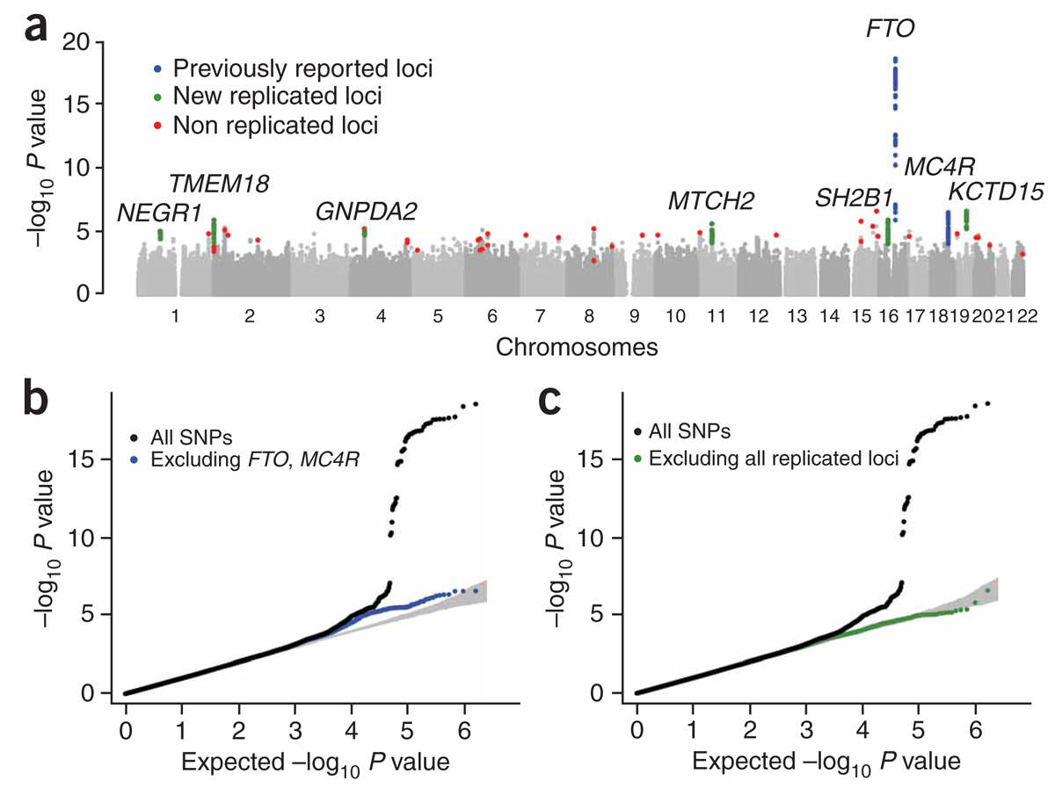
Visualizing results: Manhattan Plot
BMI GWAS (Stage 1)
(Willer et. al., Nat. Genet., 2009)

Slide 30
Visualizing results: quantile-quantile (QQ) plot)
BMI GWAS (Stage 1)
(Willer et. al., Nat. Genet., 2009)

Slide 31
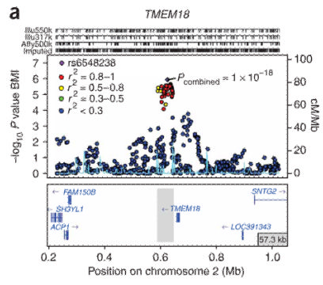
Visualizing results: regional plot
(Willer et. al., Nat. Genet., 2009)

Slide 32
Sources of association
best
Causal association
  Genetic marker alleles influence susceptibility
Linkage disequilibrium
  Genetic marker alleles associated with other nearby alleles that influence susceptibility
Population stratification
  Genetic marker is unrelated to disease alleles
useful
misleading

Slide 33
Example of spurious association due to population stratification
Population 1
Population 2
 | Allele 1 | Allele 2
Affected | 50 (f_{1,Aff}=0.2) | 200
Unaffected | 25 (f_{1,Unaff}=0.2) | 100
 | Allele 1 | Allele 2
Affected | 100 (f_{1,Aff}=0.8) | 25
Unaffected | 200 (f_{1,Aff}=0.8) | 50
χ² = 0.00 p-value = 1.0
χ² = 0.00 p-value = 1.0
Combined
 | Allele 1 | Allele 2
Affected | 150 (f_{1,Aff}=0.4) | 225
Unaffected | 225 (f_{1,Aff}=0.6) | 150
χ² = 29.2 p-value = 6.5×10⁻⁸

Slide 34
The stratification problem happens..
If..
  Phenotypes differ between populations
  and allele frequencies have drifted apart
Then..
  Unlinked markers exhibit association
  Not very useful for gene mapping!
For example, Glaucoma has prevalence of ~2% in elderly Caucasians, but ~8% in African-Americans

Slide 35
Possible solutions for population stratification
Avoid stratification by design
  Collect a better matched sample by ancestry
  Use family-based controls
    E.g. apply Transmission Disequilibrium Test (TDT)
Analyze association by population groups
  Using self reported ethnicity or genetic markers
  Carry out association analysis within each group
Account for inflated false-positive rate
  Apply genomic control
  Adjust for population principal components
  Variance component model for family-based association test

Slide 36
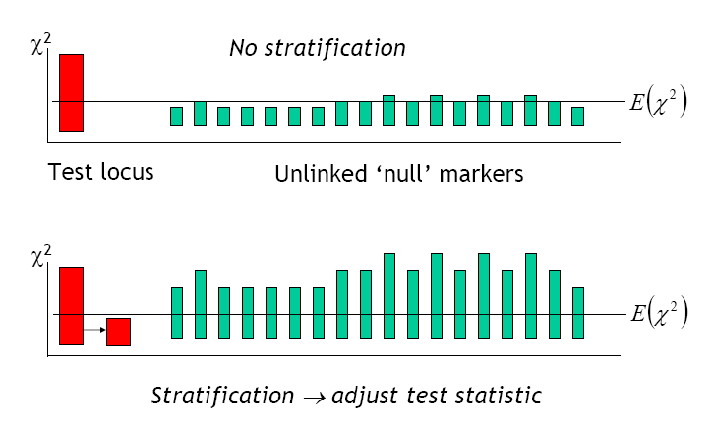
Genomic control
(Figure courtesy Shaun Purcell, Harvard, and Pak Sham, HKU)

Slide 37
Genomic inflation factor
Compute χ² statistic for each marker
Genomic inflation factor (λ)
  Median expected χ² = 0.456
    Why use median vs. mean?
Adjust statistic at candidate markers
  Replace χ²_{biased} with χ²_{fair} = χ²_{biased}/λ
  Should be λ ≥ 1
    Why?
(Devlin & Roeder, Biometrics, 1999)

Slide 38
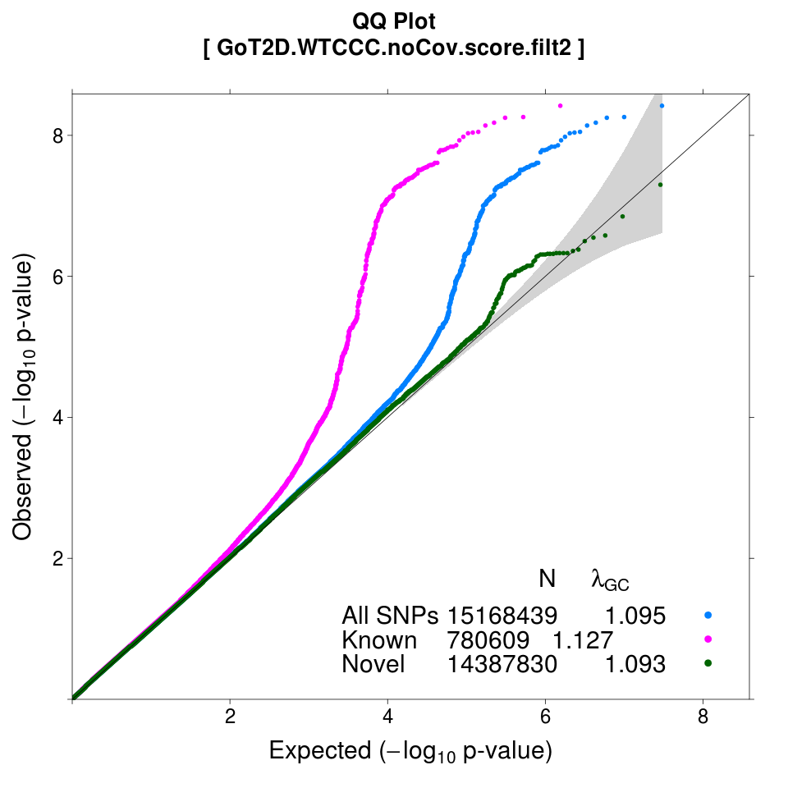
QQ plots: a useful diagnostic
Data: WTCCC Study
Phenotype: T2D status
Genotypes: imputed using GoT2D reference
Analysis: logistic regression
Classify SNPs as within or outside Known (+/-1Mb) T2D loci
For all SNPs, λ = 1.095
  Some population stratification
For Known SNPs, λ = 1.127
  Very inflated, but under alternative hypothesis

Slide 39
Genomic control example
Y
1
0
1
1
0
…
0
g₁
2
0
0
1
0
…
1
g₂
0
1
1
2
1
…
0
g₃
1
0
1
0
1
…
2
g₄ | … | g_{m}
0 |  | 2
0 |  | 1
0 |  | 2
0 |  | 2
0 |  | 1
… |  | …
0 |  | 0
χ²₁
χ²₂
χ²₃
χ²₄
χ²_{m}
Uncorrected Test Statistics

Slide 40
Genomic control example
Y
1
0
1
1
0
…
0
g₁
2
0
0
1
0
…
1
g₂
0
1
1
2
1
…
0
g₃
1
0
1
0
1
…
2
g₄ | … | g_{m}
0 |  | 2
0 |  | 1
0 |  | 2
0 |  | 2
0 |  | 1
… |  | …
0 |  | 0
χ²₁
χ²₂
χ²₃
χ²₄
χ²_{m}
Median Observed χ²
Calculate Genomic Inflation Factor

Slide 41
Genomic control example
Y
1
0
1
1
0
…
0
g₁
2
0
0
1
0
…
1
g₂
0
1
1
2
1
…
0
g₃
1
0
1
0
1
…
2
g₄ | … | g_{m}
0 |  | 2
0 |  | 1
0 |  | 2
0 |  | 2
0 |  | 1
… |  | …
0 |  | 0
χ²₁
χ²₂
χ²₃
χ²₄
χ²_{m}
Median Observed χ²
Calculate Genomic Inflation Factor
χ²_{1,fair} = χ²₁ / λ
χ²_{m,fair}
If λ ≥ 1
Corrected Test Statistics

Slide 42
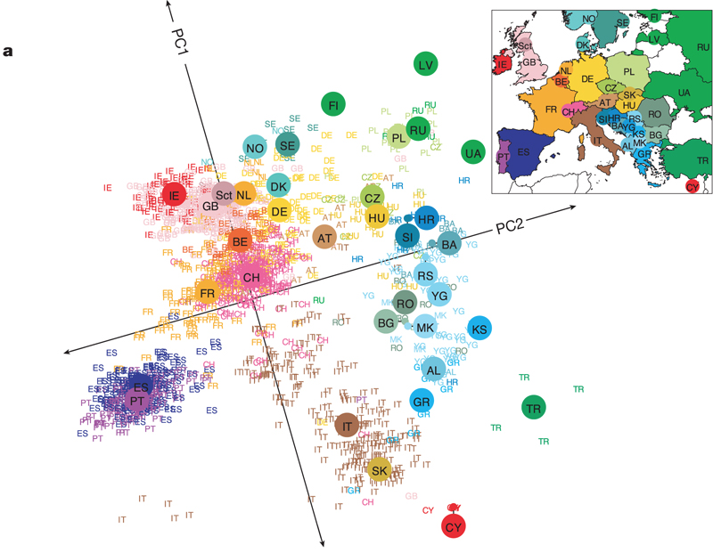
Principal components analysis (PCA)
(Figure from Novembre et. al., Nature, 2008)
Use PCA to determine “axes of genotype variation” for a selected set of genotypes
  Principal components mirror European geography
Include PC’s as covariates in regression model to adjust for stratification
(Price et. al., Nat. Genet., 2006)

Slide 43
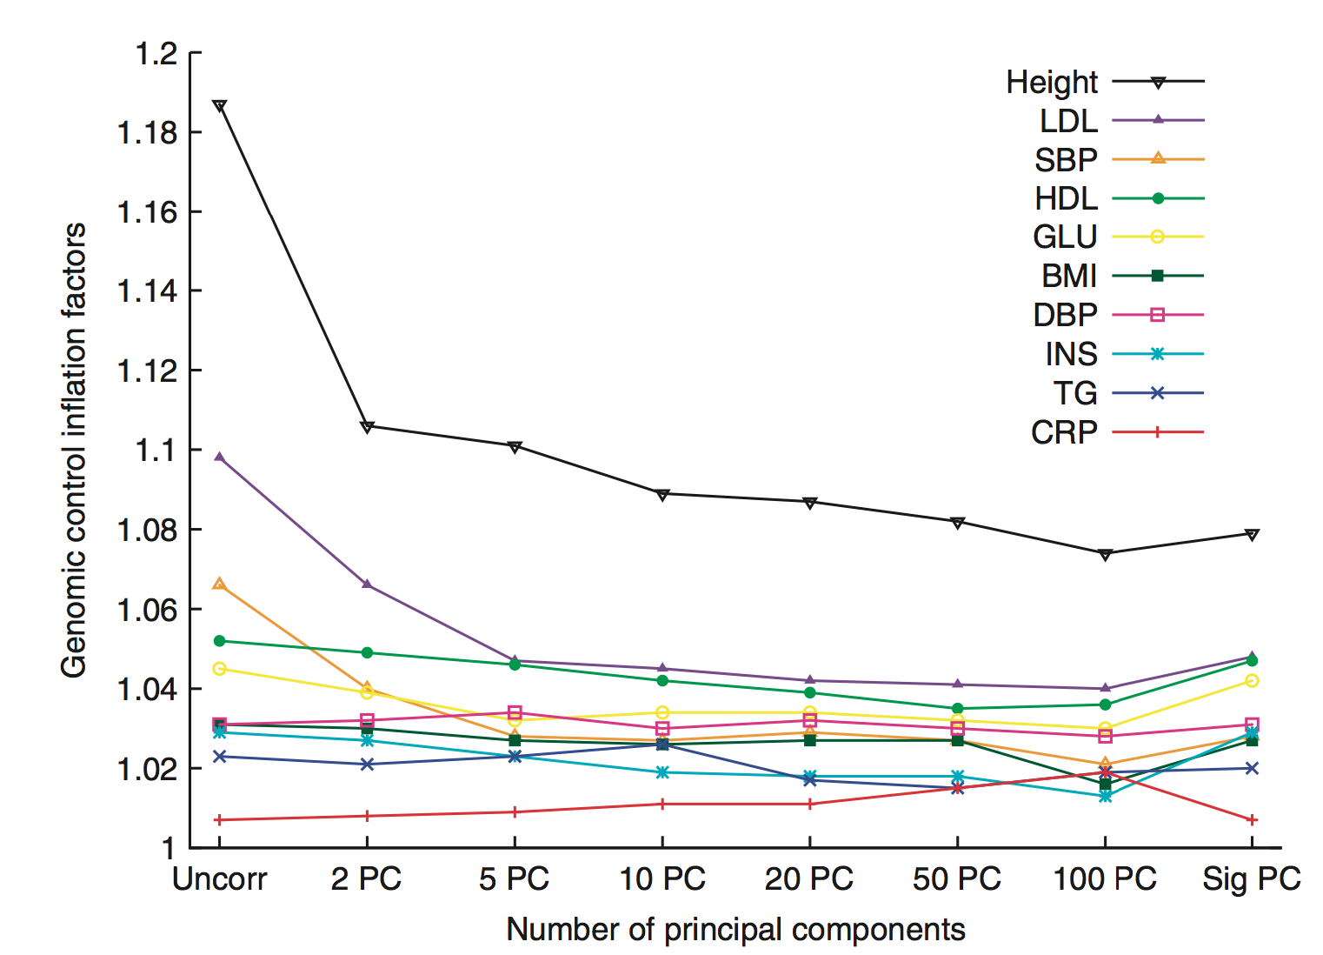
Correcting for population structure using principal components
(Kang et. al., Nat. Genet., 2010)

Slide 44
Variance component model for family-based association test
Population-based analysis assumes uncorrelated phenotypes between individuals under the null
Family-based analysis assumes phenotypes are correlated with relatives’ phenotypes
Similar model for population-based analysis to account for distant relationship inferred from dense SNP arrays
K_{ij} : kinship coefficient
: marker-based
kinship coefficient

Slide 45
Variance component model for family-based association test
Population-based analysis assumes uncorrelated phenotypes between individuals under the null
Family-based analysis assumes phenotypes are correlated with relatives’ phenotypes
Similar model for population-based analysis to account for distant relationship inferred from dense SNP arrays
K_{ij} : kinship coefficient
: marker-based
kinship coefficient

Slide 46
Variance component model for family-based association test
Population-based analysis assumes uncorrelated phenotypes between individuals under the null
Family-based analysis assumes phenotypes are correlated with relatives’ phenotypes
Similar model for population-based analysis to account for distant relationship inferred from dense SNP arrays
K_{ij} : kinship coefficient
: marker-based kinship coeff.
Kang HM et al, Nat Genet (2010) 42:348-54

Slide 47
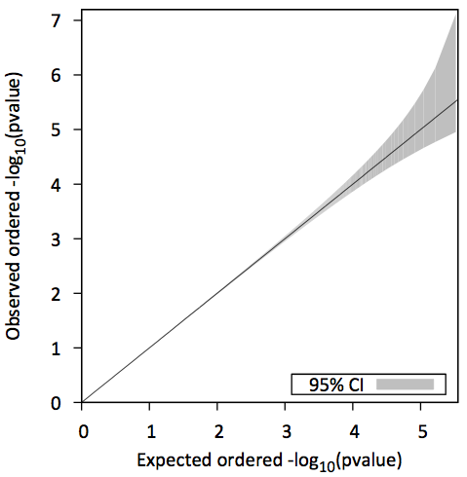
Genome-wide association of human height
uncorrected λ_{GC} = 1.187
NFBC 1966 birth cohort
  Sabatti et al, Nat Genet (2008) 41:35-46
Illumina 370,000 SNPs
5,326 unrelated individuals
95% CI : 0.992 ~ 1.008

Slide 48
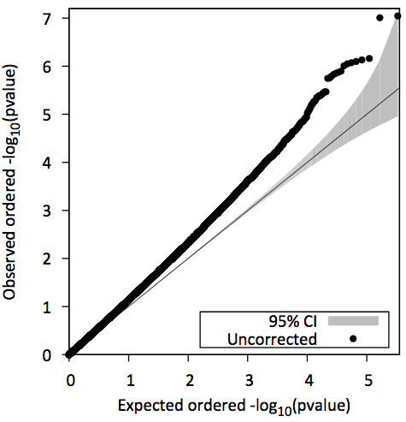

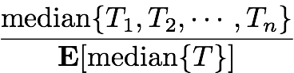
Uncorrected analysis
- Overdispersion of test statistics -
uncorrected λ_{GC} = 1.187
Devlin & Roeder Biometrics (1999) 55:997-1004

Slide 49
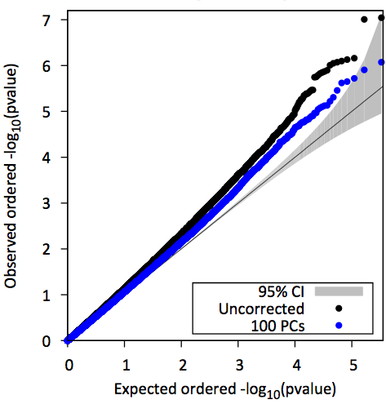

Conditioning on principal components
- Overdispersion still exists -
uncorrected λ_{GC} = 1.187
100 PCs λ_{GC} = 1.074
G is top k(=100) eigenvectors of kinship matrix K
λ_{GC} from 1.187 to 1.074
λ_{GC} is still substantially higher than expected
Corrects for population structure, but not hidden relatedness
Price AL et al, Nat Genet (2006) 38:904-909

Slide 50
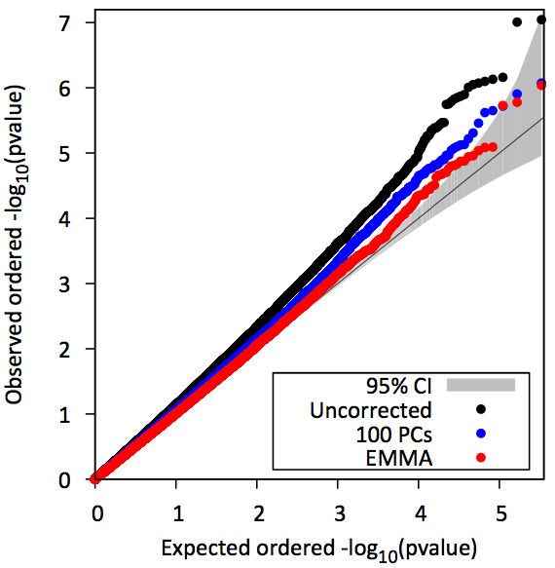
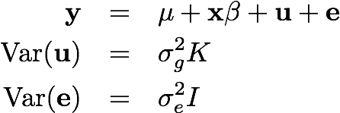
Variance component model
- Overdispersion resolved -
uncorrected λ_{GC} = 1.187
100 PCs λ_{GC} = 1.074
EMMAX λ_{GC} = 1.003
95% CI : 0.992 ~ 1.008
Using EMMAX reduced λ_{GC} from 1.187 to 1.003
λ_{GC} falls into 95% confidence intervals

Slide 51
Multiple genetic association studies
Most associated common variants have small effect sizes (e.g. odds ratios [OR] < 1.2)
To increase power to detect small genetic effect sizes, combine information across studies using
  Meta-analysis of study-level association results
  Joint analysis of all individual-level data

Slide 52
Multiple studies:
Data aggregation methods
Joint analysis
Study 1
Study 2
…
Study n
All Data
Combine individual-level data and analyze jointly

Slide 53
Multiple studies:
Data aggregation methods
Joint analysis
Meta-analysis
Study 1
Study 2
…
Study n
Study 1
Study 2
…
Study n
All Data
Combine study-level association results using:
  Inverse-variance weights
  Sample-size weights

Slide 54
Joint vs. meta-analysis
For common variants, both joint and meta-analysis are both well-calibrated, and have near-equivalent power
Meta-analysis is more commonly used
  Sharing individual-level data is difficult due to logistical and ethical restrictions
Combining multiple studies is critical to increase power to detect small effect sizes
(Lin & Zeng, Genet. Epidemiol., 2010)

Slide 55
Summary: analysis of common variants
Single variant analysis with regression-based methods have identified many trait-associated genetic variants
Important to account for population structure and/or sample relatedness to avoid spurious association

Slide 56
Analysis of Low-frequency and Rare Variants
Genetic Association Analysis

Slide 57
Genetic architecture of complex traits
Population sequencing,
Dense reference imputation into GWAS,
Specialized array genotyping

Slide 58
Why study rare variants?
  COMPLETE GENETIC ARCHITECTURE OF EACH TRAIT
Are there additional susceptibility loci to be found?
What is the contribution of each identified locus to a trait?
  Sequencing, imputation and new arrays describe variation more fully
  Rare variants are plentiful and should identify new susceptibility loci
UNDERSTAND FUNCTION LINKING EACH LOCUS TO A TRAIT
Do we have new targets for therapy?
What happens in gene knockouts?
  Use sequencing to find rare human “knockout” alleles
  Good: Results may be more clear than for animal studies
  Bad: Naturally occurring knockout alleles are extremely rare

Slide 59
Why study rare variants?
  COMPLETE GENETIC ARCHITECTURE OF EACH TRAIT
Are there additional susceptibility loci to be found?
What is the contribution of each identified locus to a trait?
  Sequencing, imputation and new arrays describe variation more fully
  Rare variants are plentiful and should identify new susceptibility loci
UNDERSTAND FUNCTION LINKING EACH LOCUS TO A TRAIT
Do we have new targets for therapy?
What happens in gene knockouts?
  Use sequencing to find rare human “knockout” alleles
  Good: Results may be more clear than for animal studies
  Bad: Naturally occurring knockout alleles are extremely rare
Coding Variants Especially Useful!

Slide 60
Lots of rare functional variants to discover
SET | # SNPs | Singletons | Doubletons | Tripletons | >3 Occurrences
Synonymous | 270,263 | 128,319 (47%) | 29,340 (11%) | 13,129 (5%) | 99,475 (37%)
Nonsynonymous | 410,956 | 234,633 (57%) | 46,740 (11%) | 19,274 (5%) | 110,309 (27%)
Nonsense | 8,913 | 6,196 (70%) | 926 (10%) | 326 (4%) | 1,465 (16%)
Non-Syn / Syn Ratio |  | 1.8 to 1 | 1.6 to 1 | 1.4 to 1 | 1.1 to 1
There is a very large reservoir of extremely rare, likely functional, coding variants.
NHLBI Exome Sequencing Project

Slide 61
Challenges for association testing of low-frequency variants
Low minor allele count (MAC)
Stringent α = 5x10⁻⁸ (multiple testing)
For binary traits:
  Unbalanced numbers of cases and controls
  (e.g. population-based studies)

Slide 62
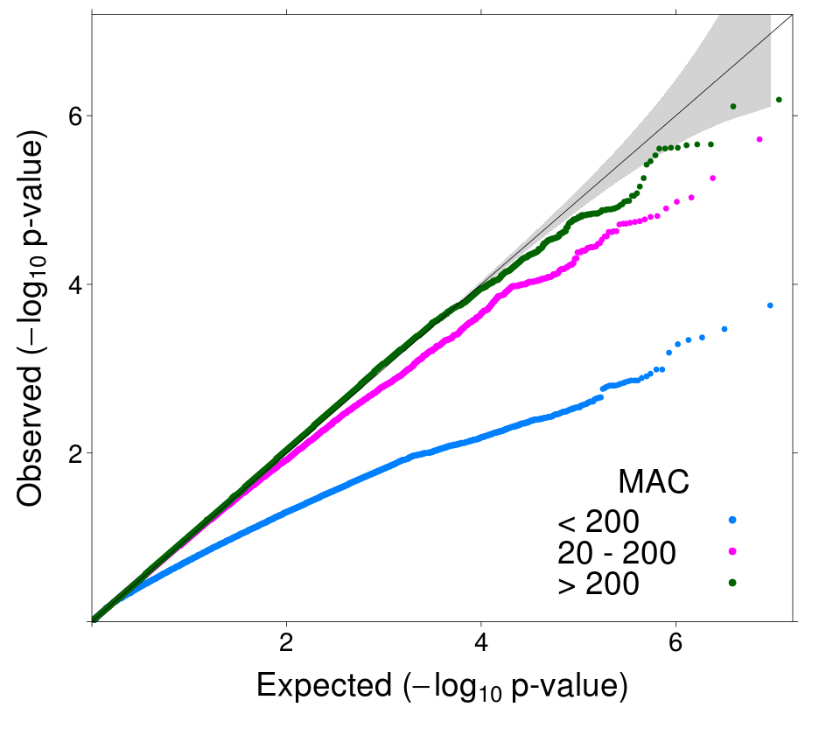
Logistic Wald test has low power* for low-frequency and rare variants in balanced studies
QQ Plot
1,060 Cases / 1,090 Controls
MAC ≥ 200
20 ≤ MAC < 200
MAC < 20
*Recently noted by Xing et al. (2012) Ann Hum Genet 76:168-77

Slide 63
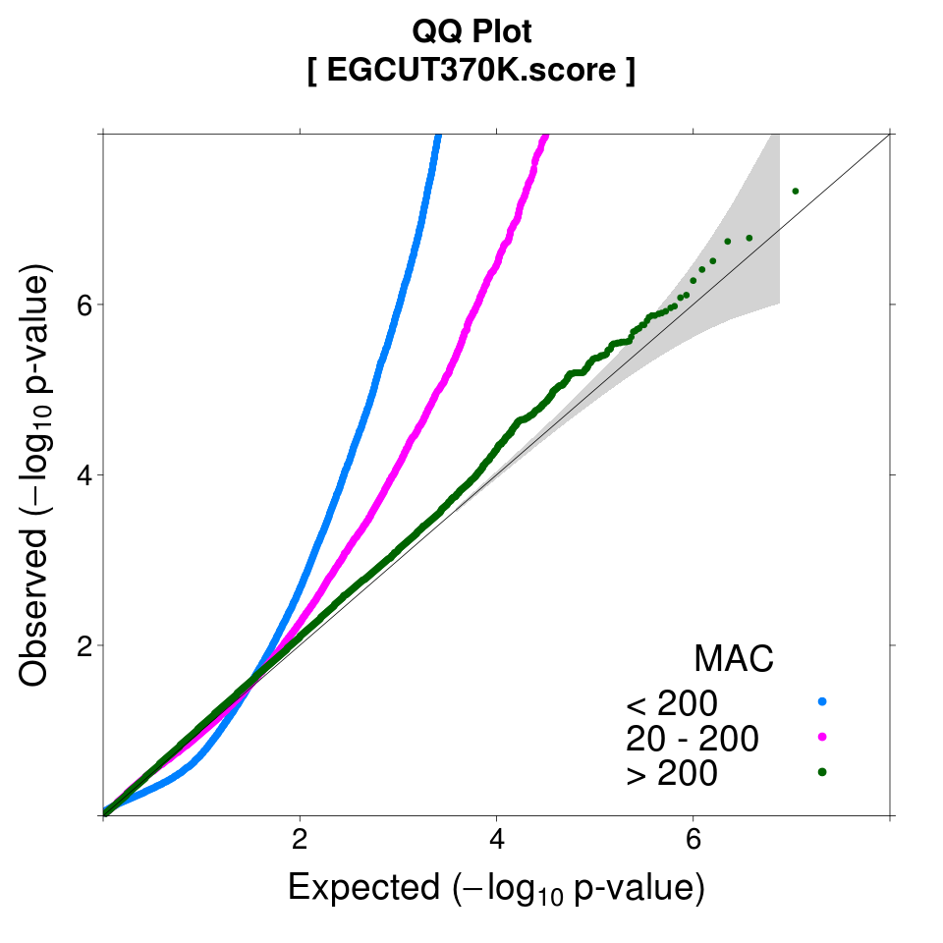
Logistic score test is anti-conservative for low-frequency and rare variants in unbalanced studies
QQ Plot
80 Cases / 1,768 Controls
20 ≤ MAC < 200
MAC < 20

Slide 64
Recommended single marker tests for low-frequency variants
Binary Traits
Quantitative Traits
For balanced studies
(case-control ratio < 3:2)
  Use Firth bias-corrected*, or score logistic regression
  Avoid Wald test (low power)
For unbalanced studies
(case-control ratio > 3:2)
  Use Firth, likelihood ratio logistic regression
  Avoid score test
  (inflated false positive rate)
Given normally-distributed QTs
  Use any linear regression test
(Ma et. al. Genet. Epidemiol., 2013;
Ma et. al., in preparation)
*(Firth, Biometrika, 1993)

Slide 65
Limitations of single marker tests
Single marker tests have low power for rare variants unless sample size very large
For binary traits, variants require minimum MAC ≥ 26 to have p-values < 5x10⁻⁸:
(No covariates; N_{cases}=N_{ctrls})
 | Cases | Ctrls
Genotype = AA | 975 | 1000
Genotype = Aa | 25 | 0
 | 1000 | 1000
 | Cases | Ctrls
Genotype = AA | 974 | 1000
Genotype = Aa | 26 | 0
 | 1000 | 1000
Fisher’s Exact Test p = 5.1x10⁻⁸
Fisher’s Exact Test p = 2.5x10⁻⁸

Slide 66
Gene-based tests
Gene-based tests jointly analyze multiple rare variants in genetic region (e.g. gene)
Increases power by:
  Combining information across rare variants
  Requiring less stringent α, e.g. α = 2.5x10⁻⁶ for 20K genes
Y
1
0
1
1
0
…
0
g₁ | g₂ | g₃
0 | 0 | 0
0 | 1 | 0
0 | 0 | 1
1 | 0 | 1
0 | 0 | 0
… | … | …
0 | 0 | 0
Σ(w_{j}g_{j})
0
1
1
2
0
…
0
Burden Test
(with weights w_{j})
(Madsen & Browning, PLoS Genet., 2009)

Slide 67
Selecting variants for gene-based tests
If include variants of all frequencies, non-causal and common variants will dilute signal
Commonly used filters or “masks”:
  Include variants MAF ≤ 0.05 or 0.01
  Weight variants by MAF
    E.g. w_{j} ~ Beta(MAF, 1, 25)
  Select variants based on functional annotation:
    E.g. Protein Truncating Variants only, nonsynonymous, missense, etc.
If mask is too restrictive, will reduce to single variant test, and no gain in power

Slide 68
Categories of aggregation tests
Burden tests test association between (weighted) sum of rare alleles with disease or QT
  CMC (Li & Leal, 2008), WSS (Madsen & Browning, 2009)
Dispersion tests measure deviations from expected distribution
  SKAT (Wu et al., 2011), C-alpha (Neale et al., 2011)
Combined tests combine strengths of burden and dispersion tests
  SKAT-O (Lee et al., 2012)

Slide 69
Power of gene-based tests
Power of gene-based tests affected by the underlying (unknown) genetic architecture of the analyzed region:
  Number of associated variants in region
  Number of neutral variants diluting signals
  Whether direction of effect is consistent within gene

Slide 70
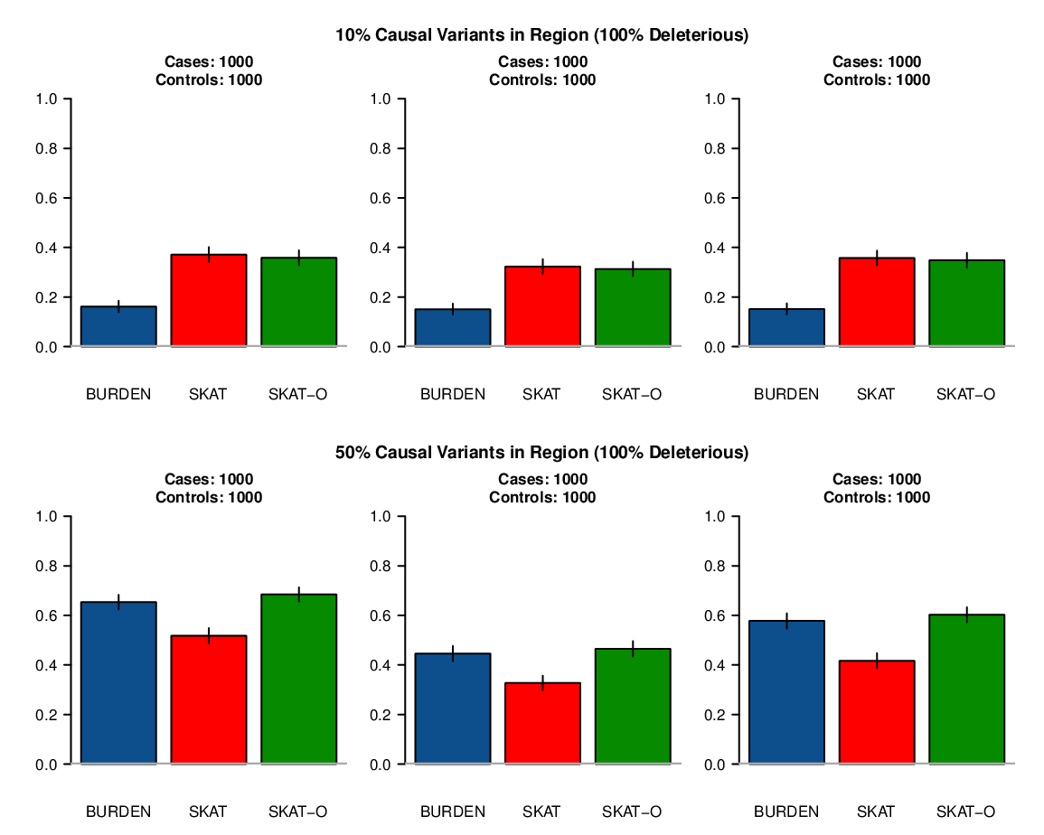
Power comparison
(All causal variants 100% deleterious)
10% Variants in Region are Causal
50% Variants in Region are Causal
Power
Power
Burden is most powerful when there are many causal variants
with same direction of effect
(Ma et al., in preparation)

Slide 71
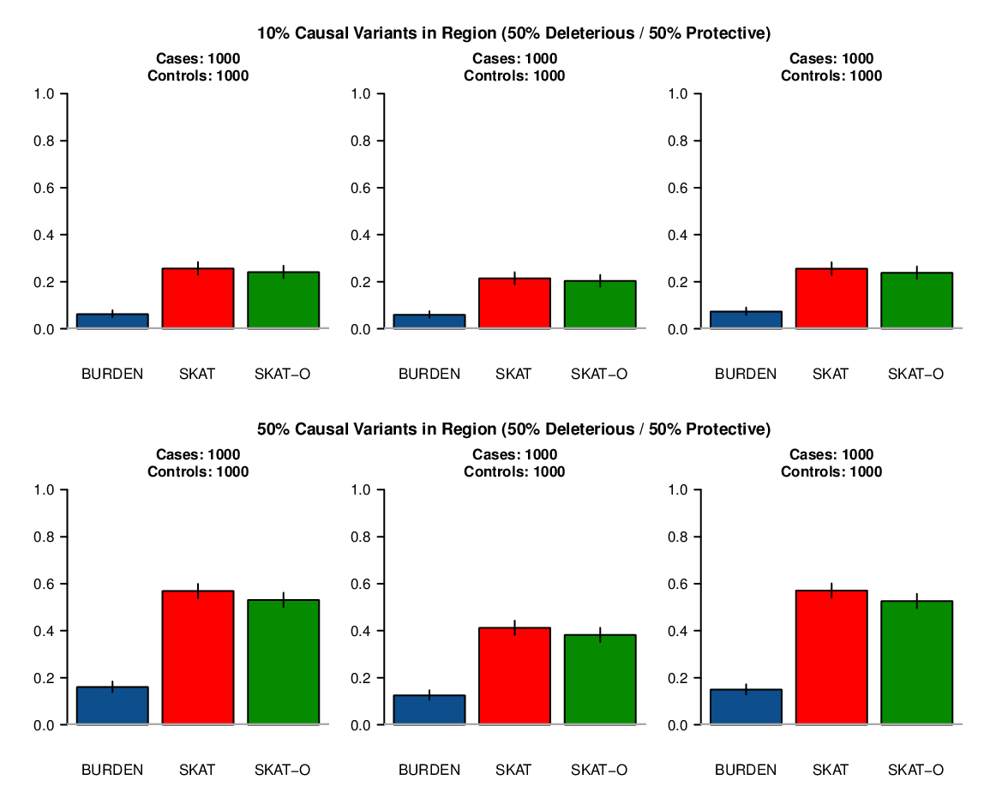
Power comparison
(Causal variants are 50% deleterious / 50% protective)
10% Variants in Region are Causal
50% Variants in Region are Causal
Power
Power
SKAT is most powerful when there are causal variants with opposite direction of effects
(Ma et al., in preparation)

Slide 72
Power comparison
(Causal variants are 50% deleterious / 50% protective)
10% Variants in Region are Causal
50% Variants in Region are Causal
Power
Power
SKAT-O is generally powerful and robust for different genetic architectures
(Ma et al., in preparation)

Slide 73
Summary: analysis of low-frequency variants
Single marker tests remain useful for low-frequency variants
  Need to carefully select well-calibrated tests
Gene-based tests can be more powerful for rare variants
  Power generally determined by underlying genetic architecture

